Slide 1
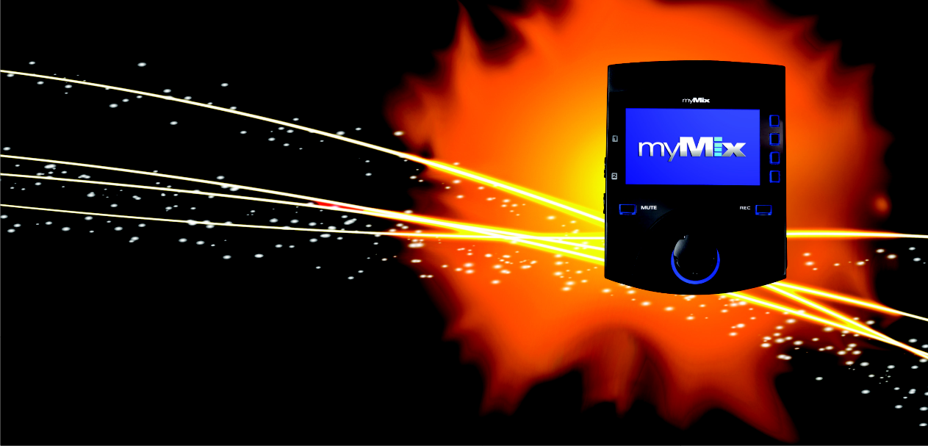
Decentralized Networkable Personal Monitor Mixing for stage, studio and other AV applications

Slide 2
Patented User Interface!
Intuitive UI- Name Based Operation
To keep musicians in „the flow“
Creativity
Imagination
Art & Music
Rhythm
Intuition
Emotion
Numbers
Sequence
Logic
Math
Lists
Analysis
Right Brain
Left Brain
Notes:
Creativity and emotion are on the other brain side than numbers, math and logic. myMix is designed to keep the operators (musicians) in their creative mind set.
And musicians wonder why the sound guy can’t comprehend the vibe they require on stage to really dig deep creatively.
It’s because they operate from different sides of the brain that, in many cases, lead to completely opposing perspectives and understanding of the situation.

Slide 3
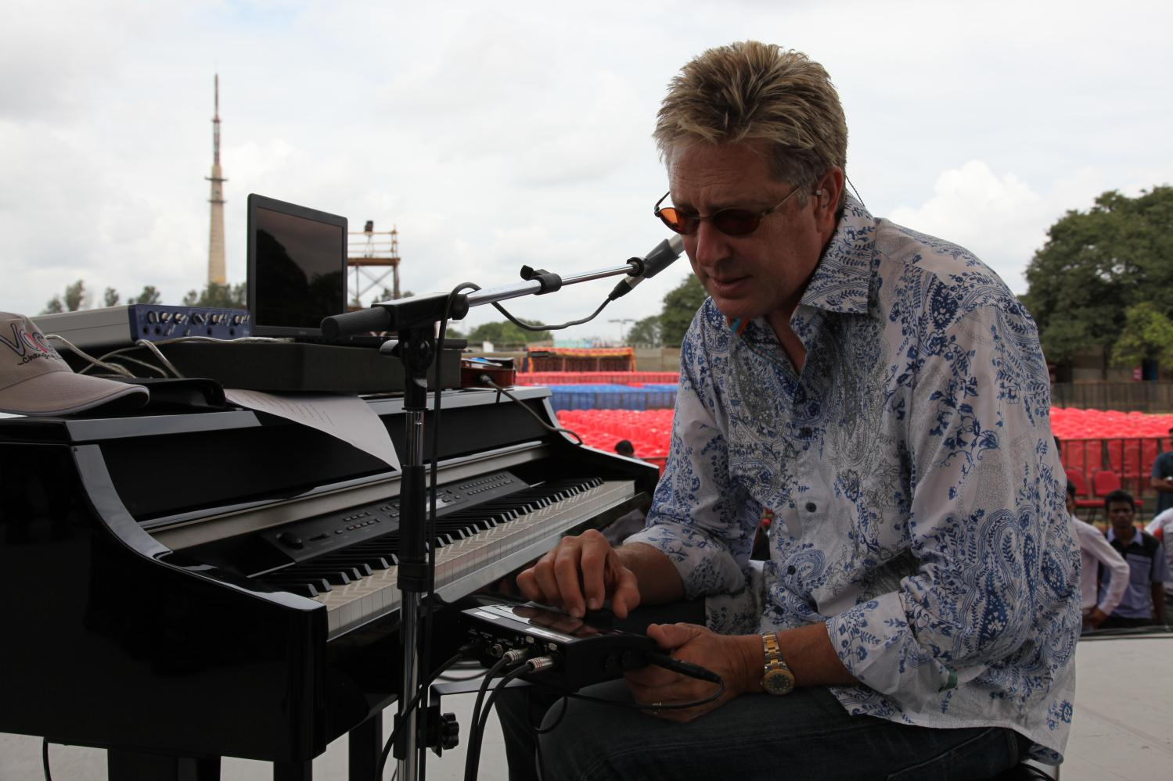
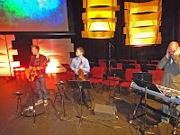
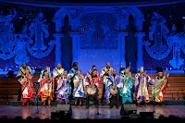
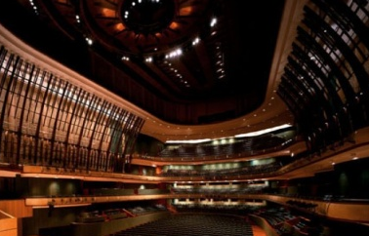
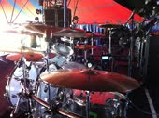
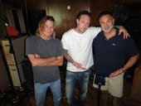
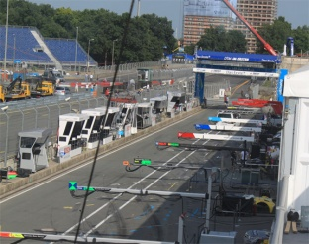
Since launch in 2010 thousands of happy musicians enjoy using myMix
Don Moen- famous musician & songwriter for contemporary christian music
Oliver Lieber – very well know producer (Paul Abdul, ..), musician (Rod Stewart, ..)
Soweto Gospel Choir – South Africa, using myMix on world tour
The Esplanade Theatre, Singapore
Opera Zurich, Switzerland
Hillsong Church, Australia
Musical „Elisabeth“, Germany
RAI, Boradcast, Italy
Grace Church, Eden Prairie, MN
Ian Haugland, Band Europe, Sweden
DTM & Formula 1 Hockenheim, Germany
and hundres of musicians, HOW, studios, ...

Slide 4
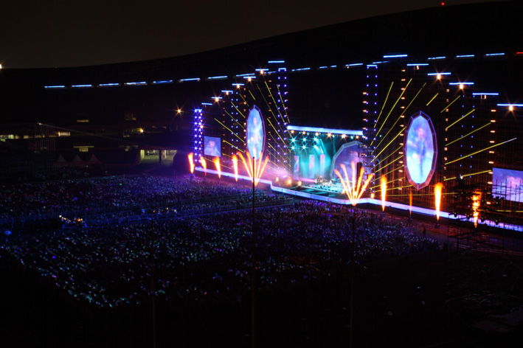
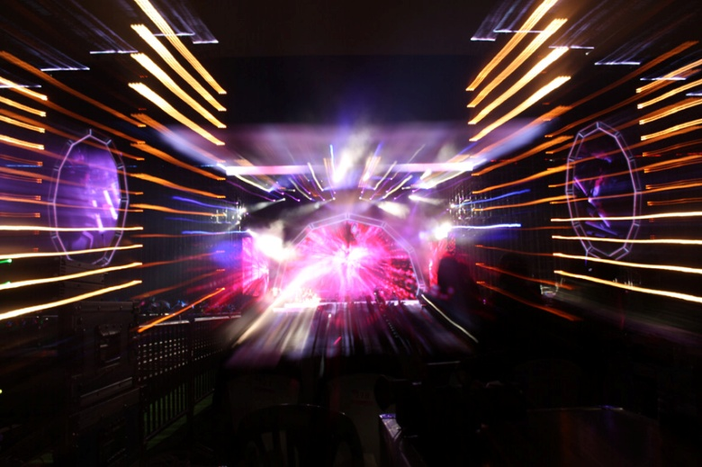
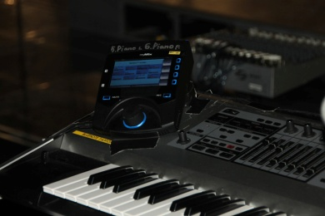
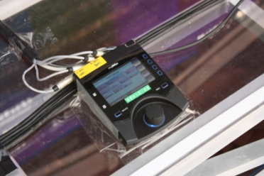
YPC Korea Tours
1 IEX16L and 8 myMix for the In-Ear Monitoring of Bass, Guitar, 2 Keyboards, 4 Vocals

Slide 5
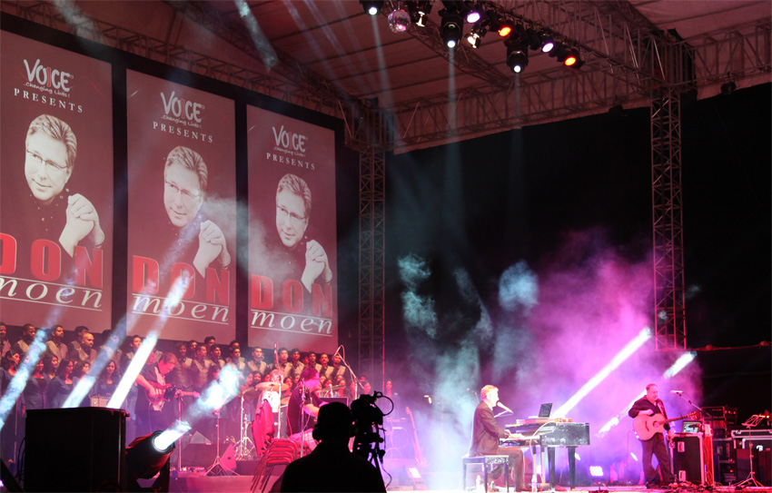
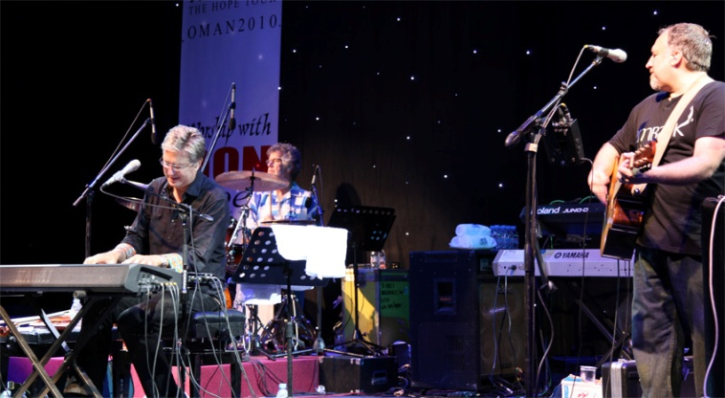
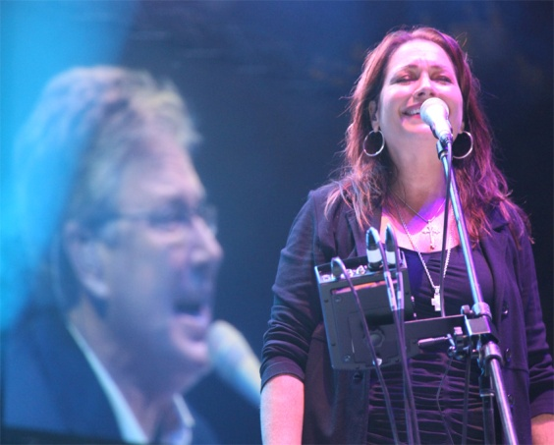
Don Moen – using myMix since 2010 all over the world
8 myMix for Don and the band

Slide 6
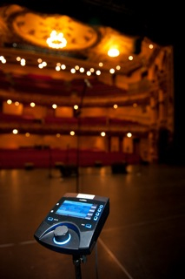
Soweto Gospel Choir – using myMix on world tour
1 IEX16, 6 myMix for the band

Slide 7
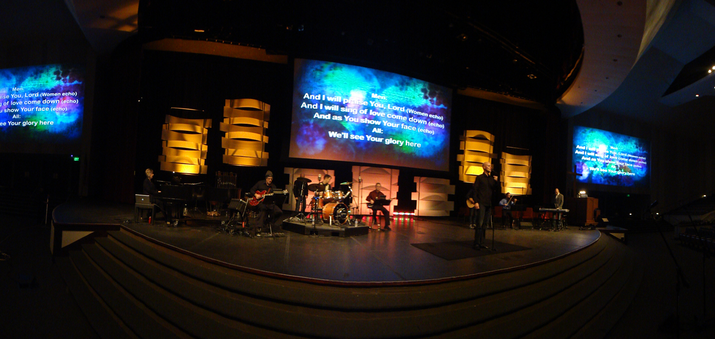
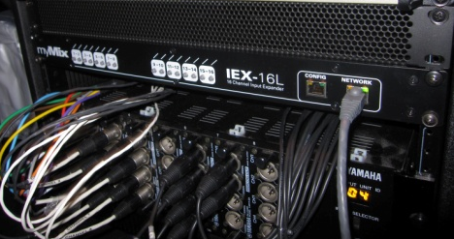
Grace Church Eden Prairie, Minnesota, USA
2 IEX16L and 12 myMix for the multiple praise bands (50+ musicians in total)

Slide 8
Musical Dream Girls Tour in South Africa
1 IEX16L and 12 myMix for the In-Ear Monitoring of the band

Slide 9
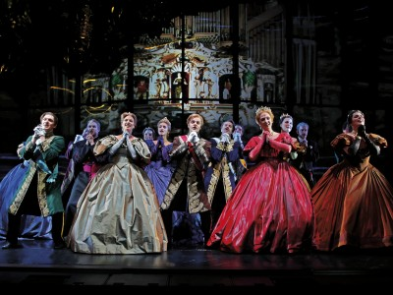
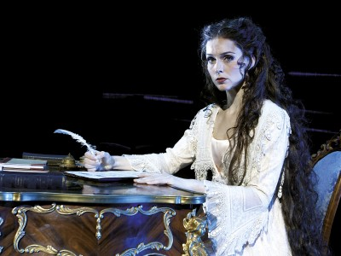
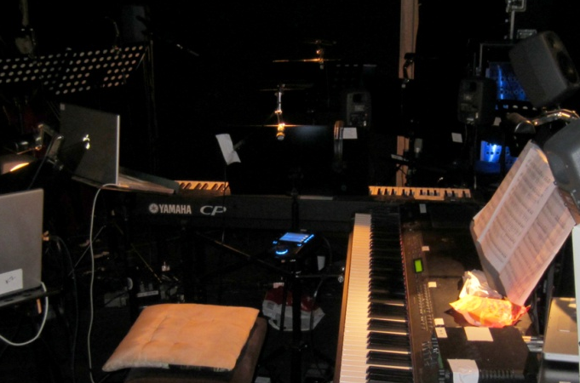
Musical Elisabeth Tour in Germany 2011/12
1 IEX16L and 15 myMix for the orchestra and conductor

Slide 10
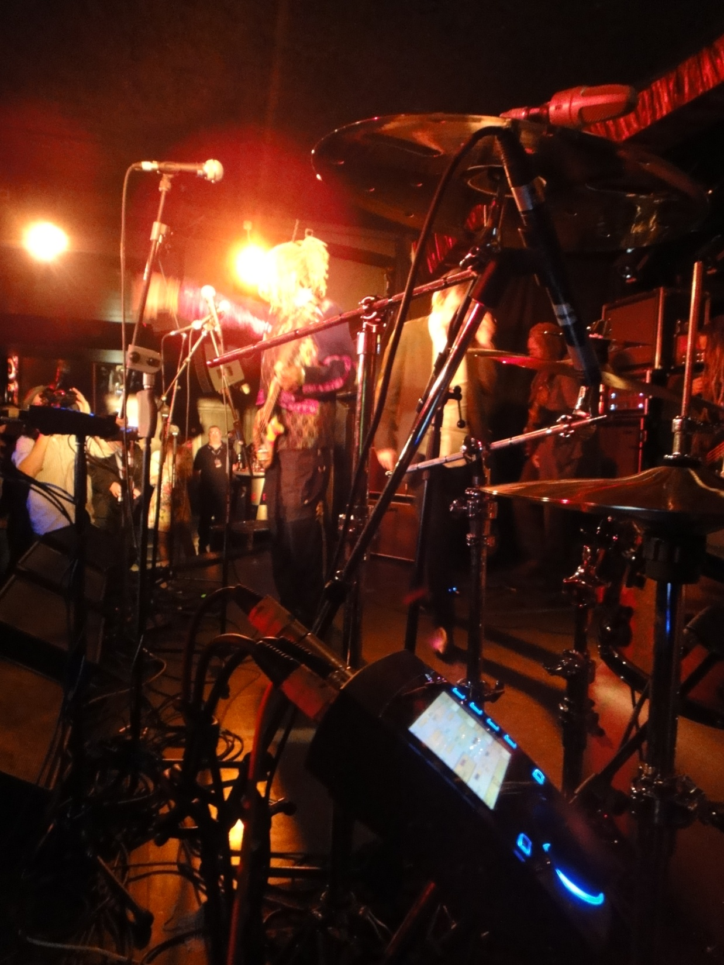
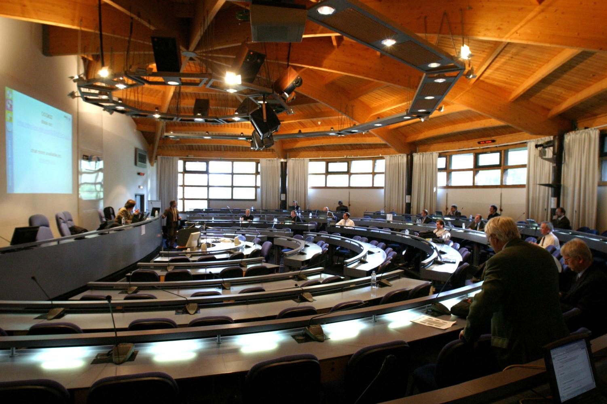
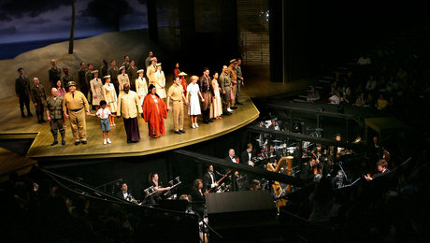

Slide 11
Decentralized, Networkable Digital Mixing Console System
Intuitive Operation
Integrated or Stand Alone
Local Inputs and Outputs
Oustanding Audio Quality (24-bit 48kHz)
Additional Audio Inputs- analogue or digital
Integrated Multitrack Recording (16 tracks + mix) and Playback / Play Along

Slide 12
Unlimited number of myMix mixers on a network
Capable of hundreds of audio channels on the network
Each myMix can individually select 16 audio channels (8 pairs) to create a local mix
Local Mix can be send to network and selected by other myMixes

Slide 13
Each channel can be controled in volume, tone, FX, Pan, Solo and Mute
Name based operation for ease of use
Works on conventional Fast Ethernet Network-
Uses early version of Ethernet AVB – ready for the future
Settings and configuration are auto saved in a profile – 20 different profiles available

Slide 14
Designed for intuitive and easy operation

Slide 15
Right Brain
Left Brain
Creativity
Imagination
Art & Music
Rhythm
Intuition
Emotion
Numbers
Sequence
Logic
Math
Lists
Analysis
Notes:
Creativity and emotion are on the other brain side than numbers, math and logic. myMix is designed to keep the operators (musicians) in their creative mind set.
And musicians wonder why the sound guy can’t comprehend the vibe they require on stage to really dig deep creatively.
It’s because they operate from different sides of the brain that, in many cases, lead to completely opposing perspectives and understanding of the situation.

Slide 16
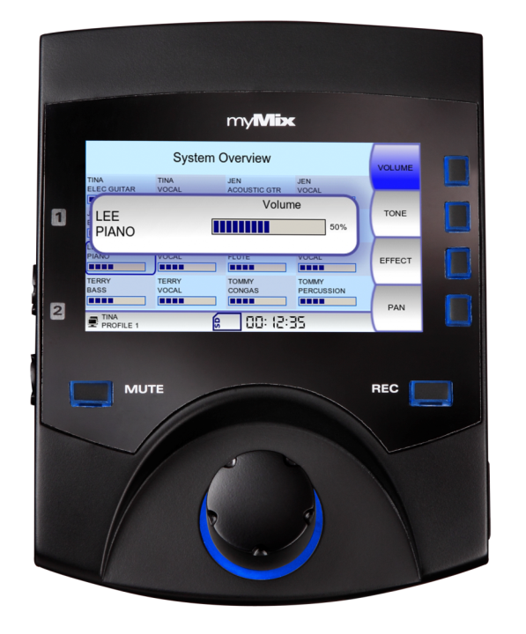
Name Based Operation – no channel numbers
Big Encoder Wheel – no fiddling with tiny pots
Big LCD Screen showing ALL channels – no searching

Slide 17
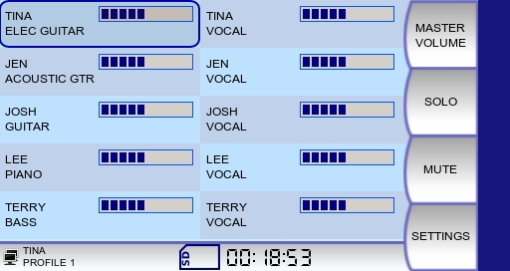
myMix channel auto discovery

Slide 18
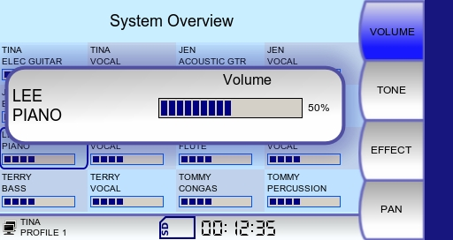
Click on channel to bring up channel detail (defaults to volume)

Slide 19
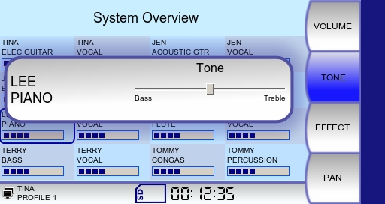
Click on corresponding function button for tone

Slide 20
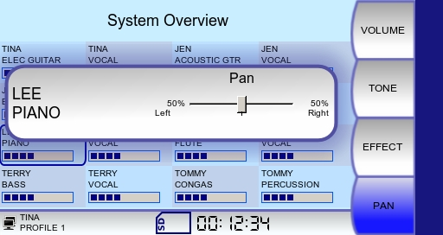
pan or balance in the stereo image

Slide 21
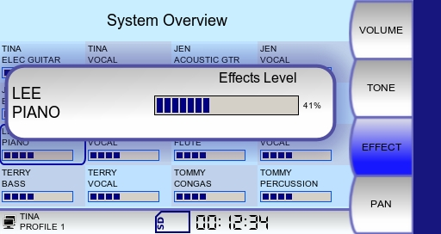
…for effect send level
Stereo Effect Unit for a 3-D Sound Image

Slide 22
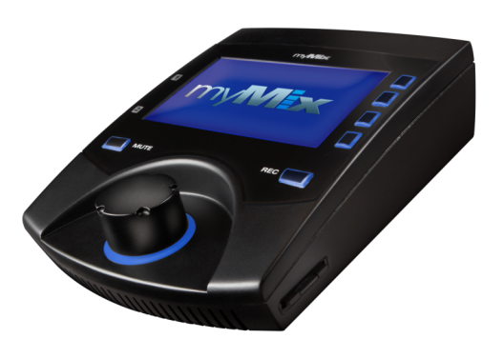
The system components
IEX16L: 16 channel line level expander
myMix: 16/2 mixer, 2 Inputs, 2 Outputs
IEX16L-A with 16 digital inputs (ADAT, 24-bit / 48kHz)
Standard Fast Ethernet Switch
Unmanaged for up to 16 channels
Managed (IGMP Snooping) for > 16 channels

Slide 23
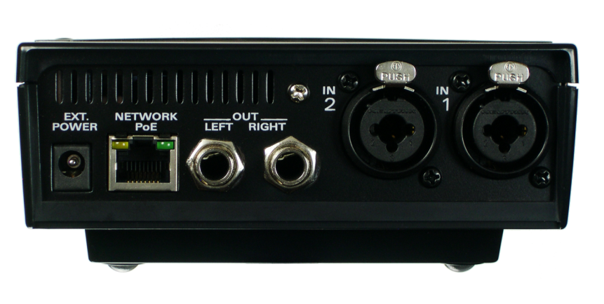
Network Outputs
Network Inputs
Combo ¼” XLR/Jack, Mic/Line Input (Neutrik)
DC Power
RJ45 Ethernet Netzwork
Balanced ¼” TRS Jacks
Mix Output (Neutrik)

Slide 24
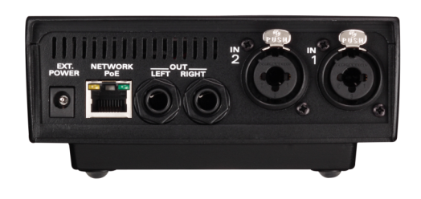
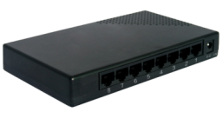
Each myMix has 2 inputs (mic/line) and the output for the stereo mix (line& headphone).
Each IEX16L has 16 inputs (line level or digital)
Every device gets connected to a Fast Ethernet Switch
Notes:
Example using Y-cable

Slide 25
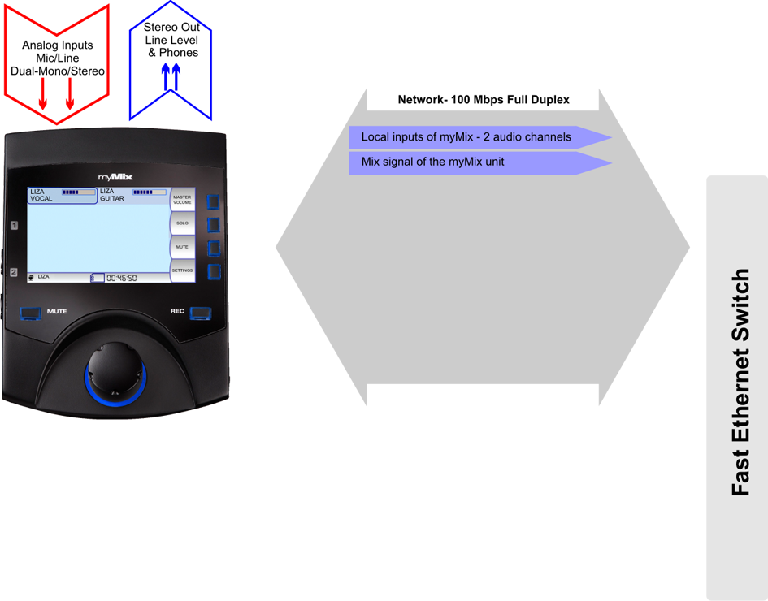
Inputs
Mix Out
100Mbps Ethernet CAT5
When the local inputs (dual mono / stereo) are activated they are send to the network. The stereo mix can also be send to the network.
Notes:
Example using Y-cable

Slide 26
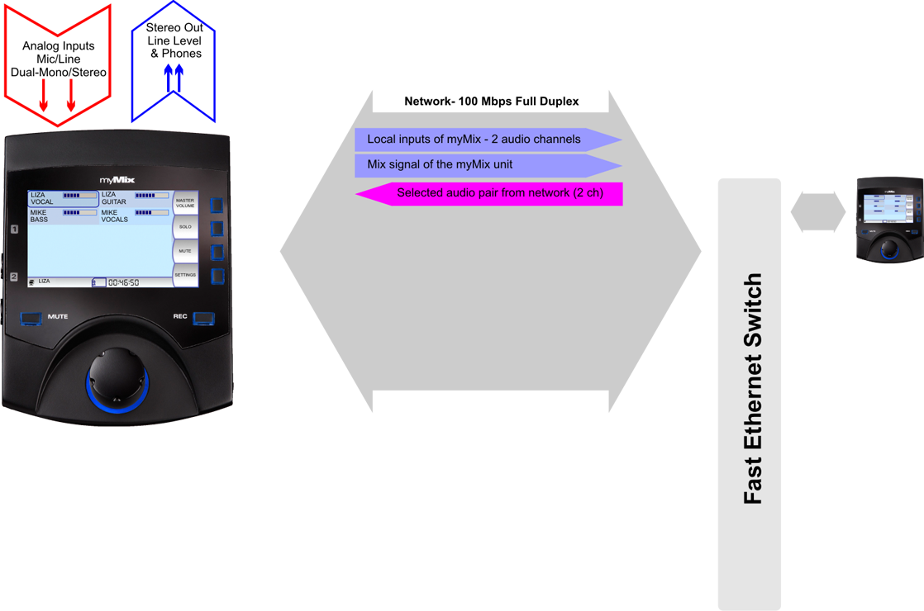
Inputs
Mix Out
100Mbps Ethernet CAT5
Connecting a 2nd myMix with activated inputs makes 2 more channels available.
Notes:
Example using Y-cable

Slide 27
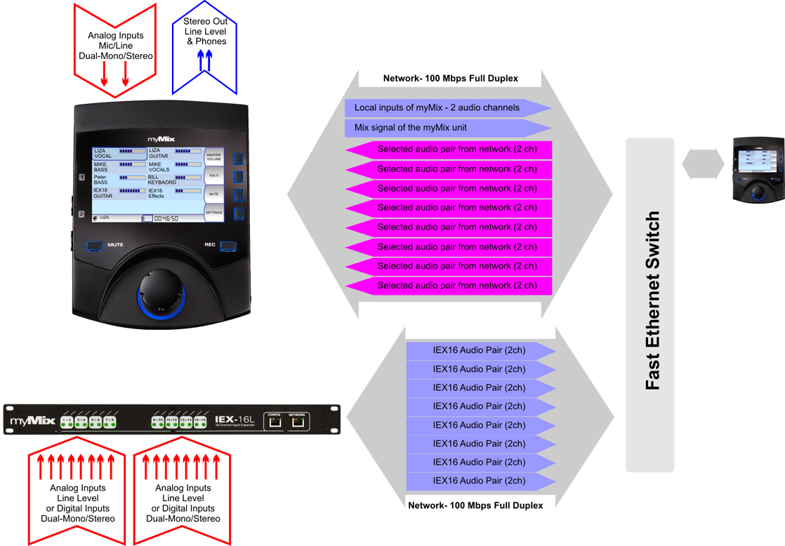
Inputs
Mix Out
100Mbps Ethernet CAT5
16 Inputs: Analog/Digital
A IEX16L adds 16 more audio signals to the network.

Slide 28
Inputs
Mix Out
100Mbps Ethernet CAT5
16 Inputs: Analog/Digital
A IEX16L adds 16 more audio signals to the network.
There‘s virtually no limitation as too how many myMix and IEX are being used.

Slide 29
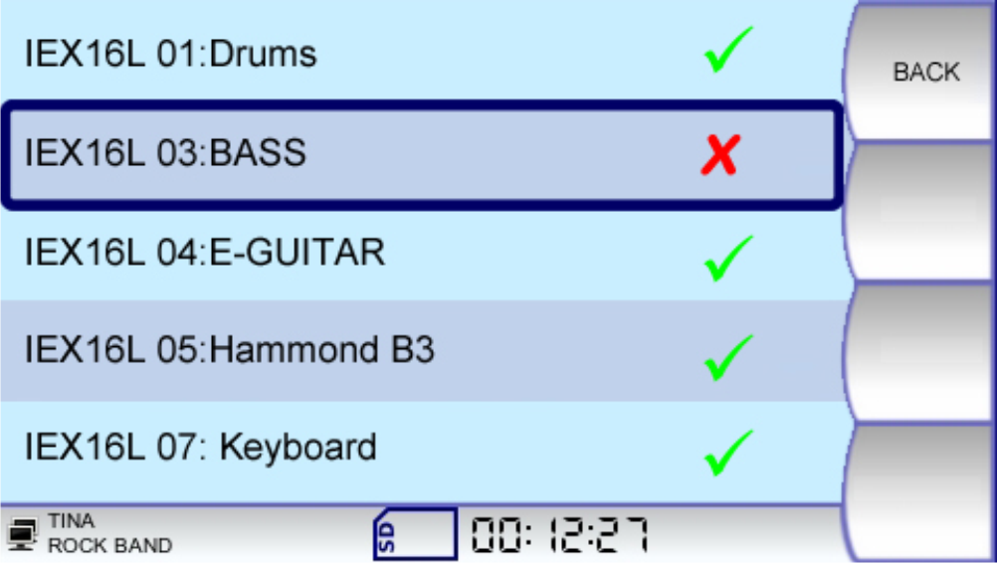
Inputs
Mix Out
Each myMix can have an individual selection of 8 input pairs (max 16 channels). In Remote Channel Select everybody can choose which signals (mono or stereo) are being used for the stereo mix. This can include any network signal, including the mix from another myMix device.
Notes:
Example using Y-cable

Slide 30
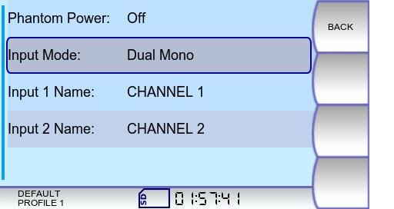
Inputs
Mix Out
The MAC address of the sending device and the channel name determin the identification on the network. Changing input names turn the same physical input into a new channel.
Notes:
Example using Y-cable

Slide 31
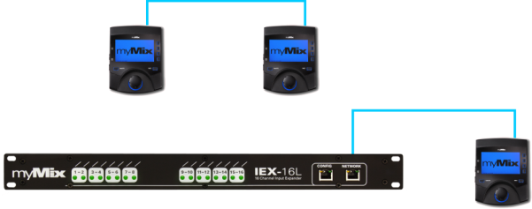
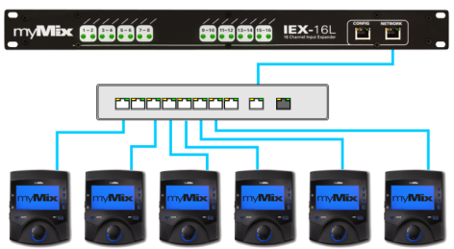
myMix Networks-
No proprietary master or center unit
The smallest system is to connect two myMix to each other, or one myMix to an IEX16 input expander.
The typical network uses an Fast Ethernet Switch – with IGMP snooping for >16 network channels
Notes:
Example using Y-cable

Slide 32
myMix Networks
Two switches can be linked via a GB uplink port.
Notes:
Example using Y-cable

Slide 33
myMix Networks
System with multiple switches use one central GB switch.
Notes:
Example using Y-cable

Slide 34
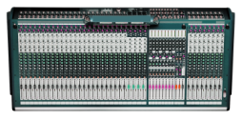
The Personal Mixer – Integrated or Stand Alone
On Stage-
Personal Monitoring &Recording
Large System with IEX-16L,
Managed Switches, Console
Rehearsal, Youth Group, or Session
Unmanaged Switch, No Console required-
Personal Mix & Recording
Single Unit-
Playback or play along recodings or preproduced multi-track files for rehearsing

Slide 35
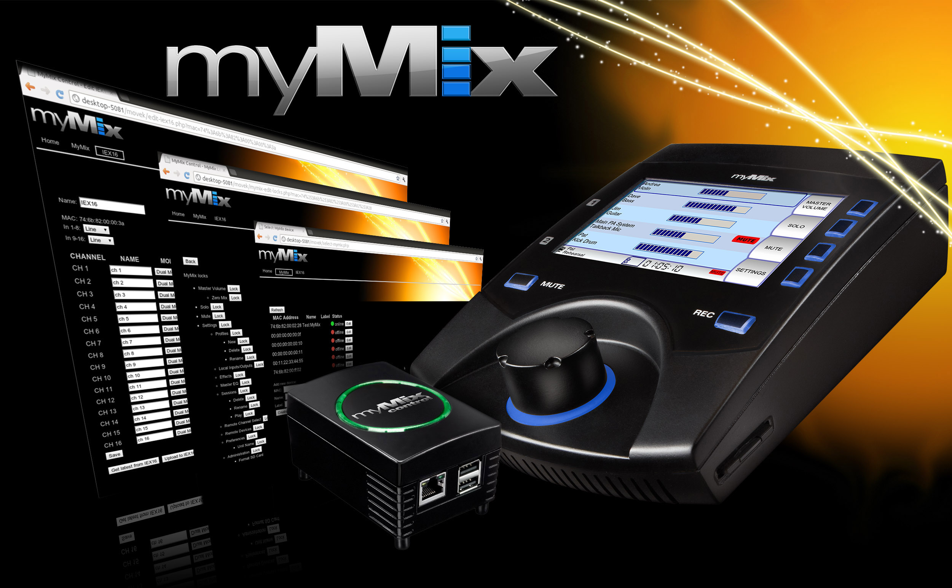
myMix CONTROL

Slide 36
myMix CONTROL-
Configure and edit any parameter in the system
myMix Plug Computer with WiFi 802.11b/g access point
USB port for external data storage
Universal Web Browser Interface - No dedicated computer needed
Backup/Download of complete system settings
Individual Configuration and Editing of myMix and IEX16
Global Profile Change for myMix
Locking Menu with individual parameter locking per myMix
Offline Editing
Remote access to individual parameters including mixing

Slide 37
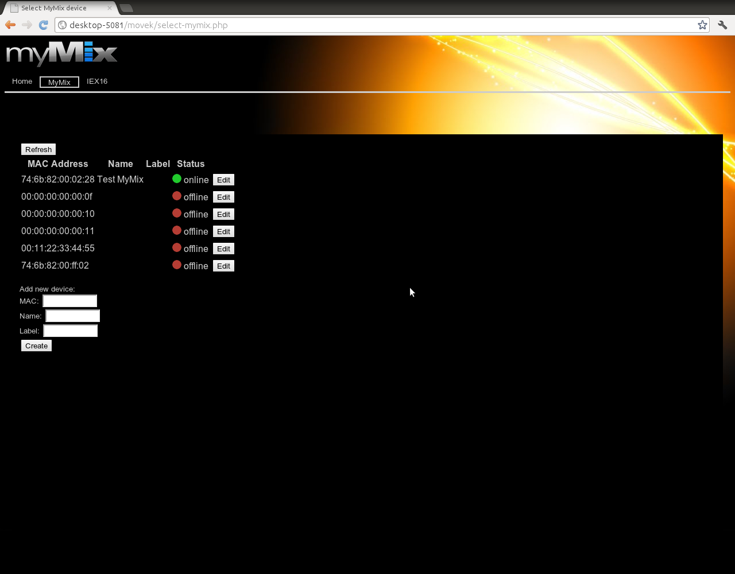
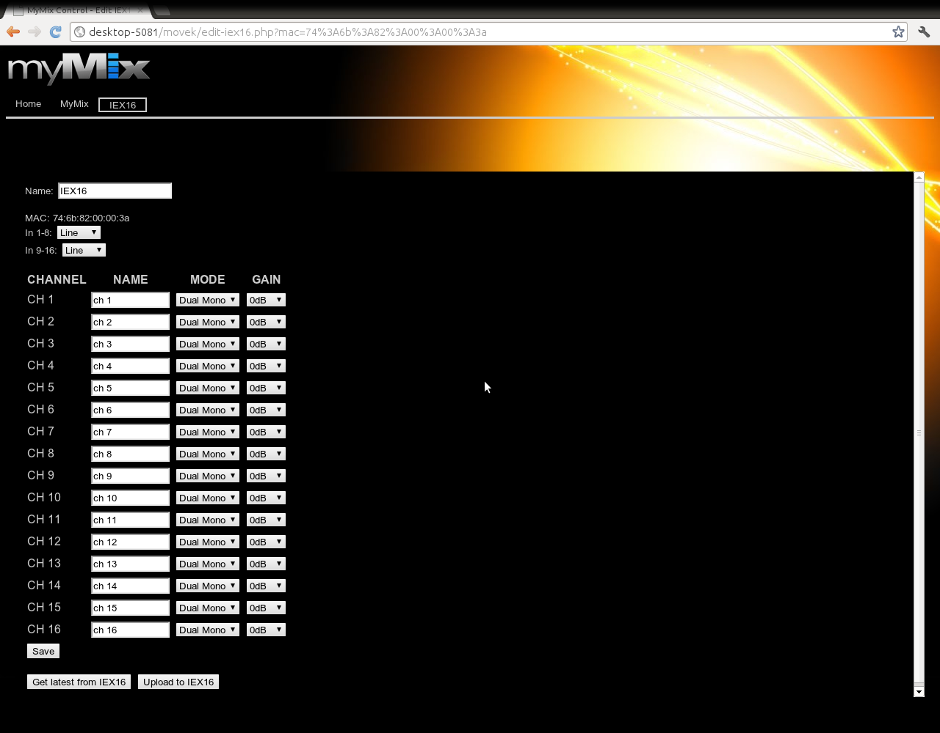
myMix CONTROL-
Configure and edit any parameter in the system
myMix in the System
Locking
Config myMix
IEX16 Configuration
Web Browser Interface - independent

Slide 38
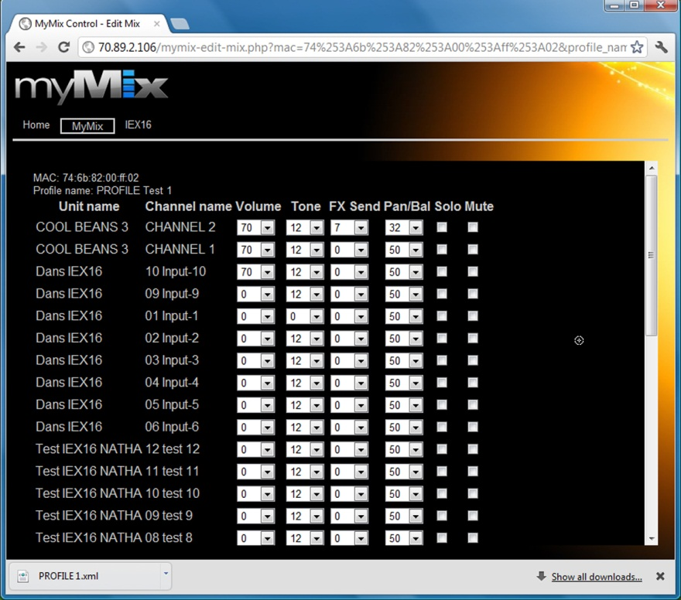

Slide 39
intEGRATE

Slide 40
50 + Musicians want to control their instrument
And hear the others
47 individual instruments are provided as network signal (50 channels)
16 submixes are provided
66 network signals available
64ch via MADI interface and IEX16L-A
Network with central GB Switch

Slide 41
For a maximum of 64 input channels to myMix
Notes:
So what is myMix. It is a ...........
The way you know consoles is that all signals come centralized into the mixer. You change the signal and send it out again.
With myMix each mixer has all information about everything and therefore there is no centralized system.

Slide 42
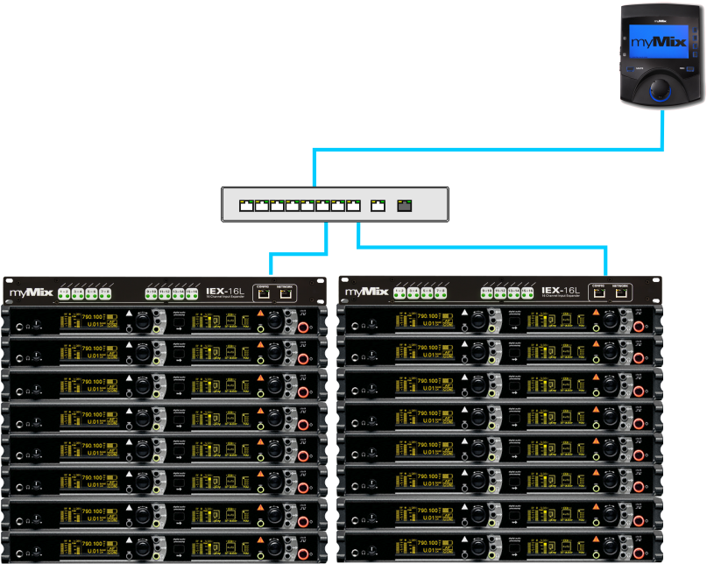
Remote Cue System for Wireless Receivers
Easy connection via CAT5
Switches can be used as repeaters
Optical cable can be used for even longer distances
One IEX16L can handle 16 channels,
Use profiles in myMix in banks of 16, or use one myMix per 16ch

Slide 44
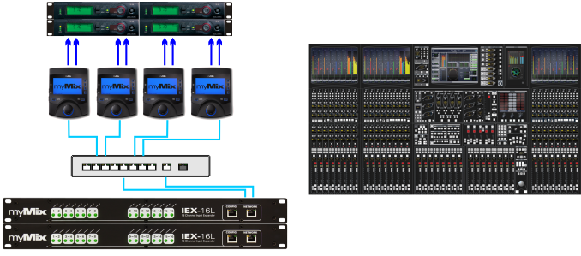
Integration with House PA
Providing the mix signals to remote wireless transmitters
myMix units on stage send mix to network
myMix units are placed next to the wireless transmitters
Each myMix has selected one stereo mix and provides that signal to the TX
Switches are connected via the uplink port (can also be used for IEX-16)

Slide 45
High Quality Spound Distribution between Stages
Easy connection via CAT5
Switches can be used as repeaters
Optical cable can be used for even longer distances
Local Inputs
Use two units to have one for cue and one for program

Slide 46
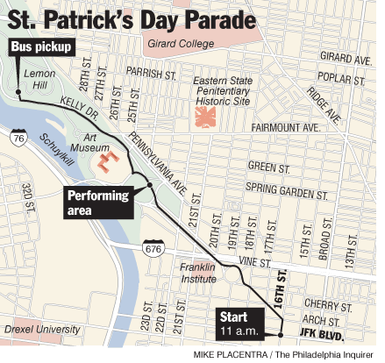
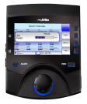

Slide 47
Intercom-Talkback System
Easy connection via CAT5
Switches can be used as repeaters
Optical cable can be used for even longer distances
Use different names for the local TB mic to talk to different people
Listeners can not only select but also adjust individual levels

Slide 50
Music Schools- Education
myMix will..
Allow a signle teacher to listen to multiple students from one location
Record at any time for later rehearsal at home
Fast set-up changing using profiles
A „band or group feeling“ for students when playing along to SD card tracks
Allow a teacher even to talk to individual students (using profiles!)
Provide a competitive advantage for the music school
Provide an additional source of income from renting myMix devices to students

Slide 51
Talk to an indivual student with one talkback mic using profiles
Teacher | Profile: Student 1-8
Student 01 | Student 02
Student 03 | Student 04
Student 05 | Student 06
Student 07 | Student 08
Teacher creates on profile for a group of students and one for each single student
The channel name for the talkback mic gets a different name in each profile
Students will always listen to teacher, but only hear signal once teachet selcets their profile (or all)
Input Channel1: Talkback All
Teacher | Profile: Student 1
Student 01 | TB Students
Student 1 | Profile: Solo
Keyboard 1 | Talkback 01
 | Teacher 01
Only student 1 has selcetd Teacher01 and Talkback 01
Input Channel1: Talkback 1
Teacher | Profile: Student 2
Student 02 | TB Students
Student 2 | Profile: Solo
Keyboard 2 | Talkback 02
 | Teacher 02
Only student 2 has selcetd Teacher 02 and Talkback 02
Input Channel1: Talkback 2

Slide 53
Thank you very much!

