Slide 1

Notes:
myMix was designed by us because so many Musicians approached us complaining about not getting the sound the way the want it. The usual problem. The lead vocal was loud enough and the drummer was too loud and they hardly ever got good sound. There is a lot of material out there addressing this problem but most of them are too technical and too compliacted to handle for musicians who very often are technically challenged. If you confront a musician with having to ajust his sound with a fully parametic 4 band EQ than he won‘t be at ease most likely.
So we wanted to come up with something which pleases the musicians and the engineers. Out come myMix the very first easy to use decentralized digital mixer. It

Slide 2
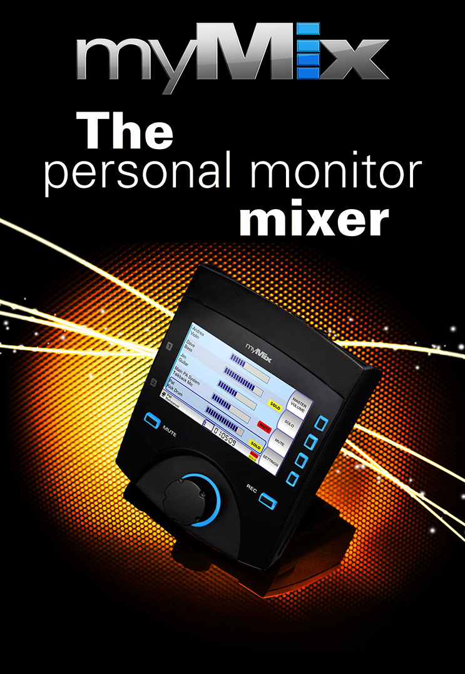

Slide 3
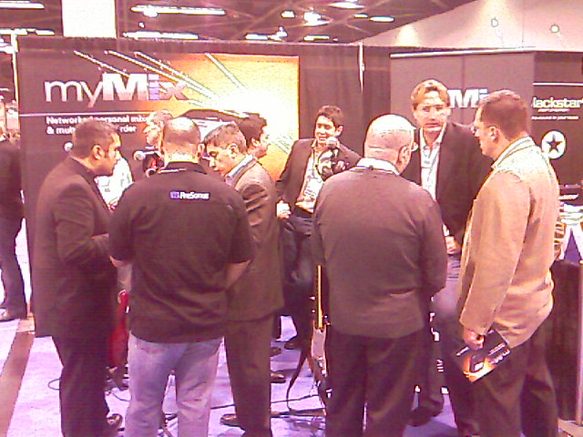

Slide 4
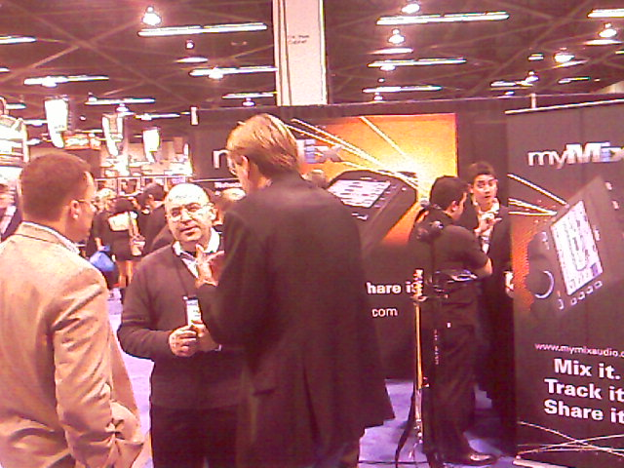

Slide 5
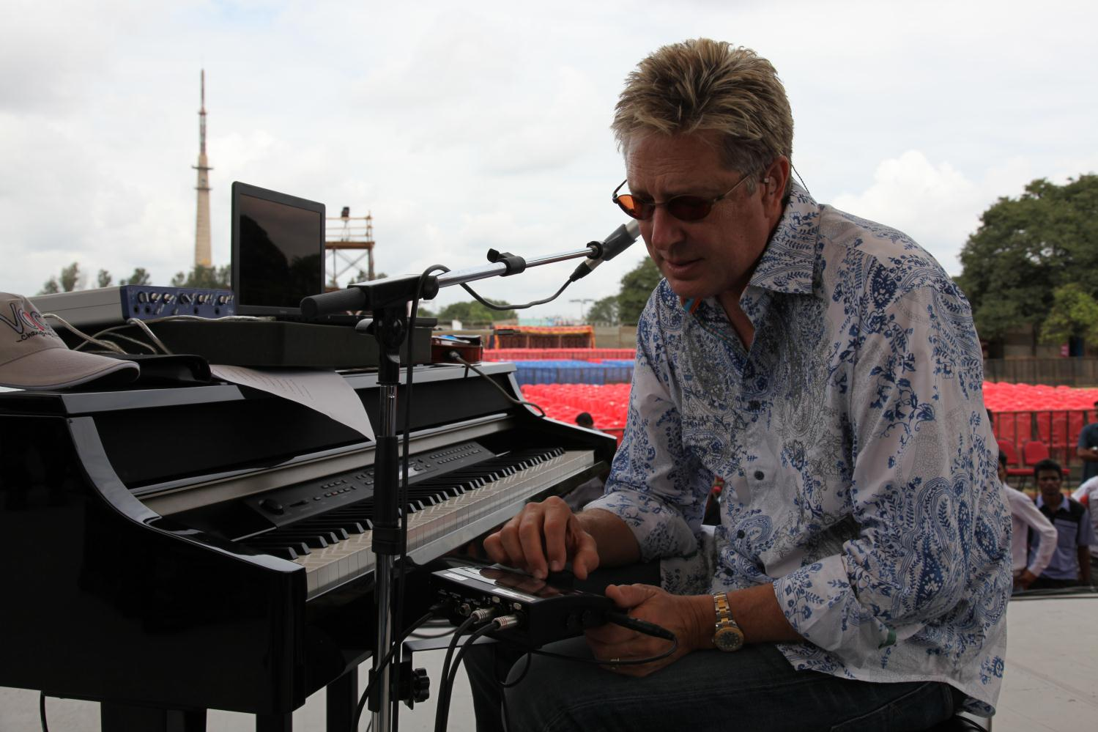
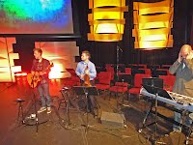
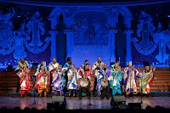
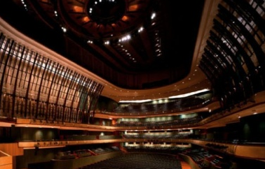
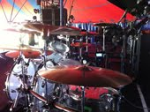
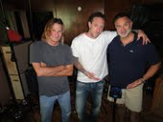

Tausende zufriedene myMix Anwender
Don Moen- famous musician & songwriter for contemporary christian music
Oliver Leiber – very well know producer (Paul Abdul, ..), musician (Rod Stewart, ..)
Soweto Gospel Choir – South Africa, using myMix on world tour
The Esplanade Theatre, Singapore
Opera Zurich, Switzerland
Hillsong Church, Australia
Musical „Elisabeth“, Germany
RAI, Boradcast, Italy
Grace Church, Eden Prairie, MN
Ian Haugland, Band Europe, Sweden
Und weitere hunderte Bands, Studios, Kirchen, ...

Slide 6
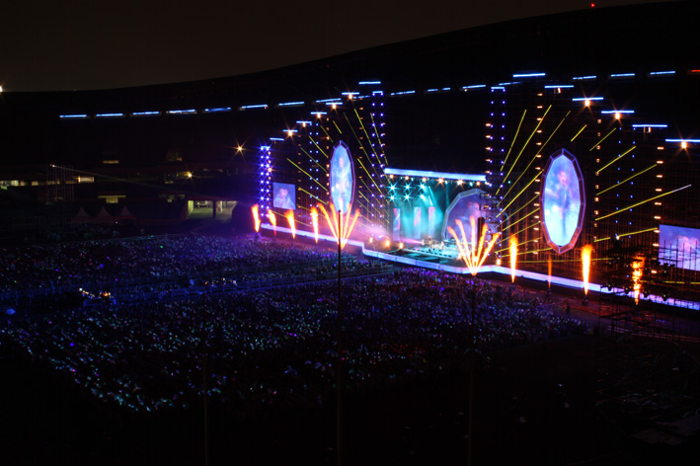
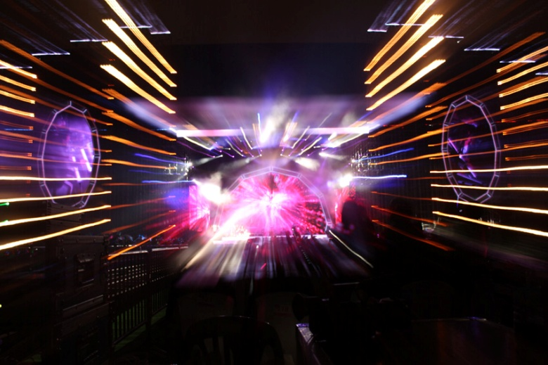
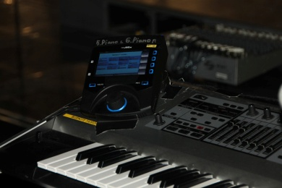
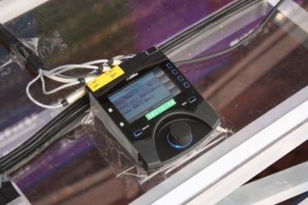
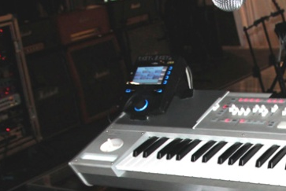
YPC Korea Tours
1 IEX16L and 8 myMix for the In-Ear Monitoring of Bass, Guitar, 2 Keyboards, 4 Vocals

Slide 7
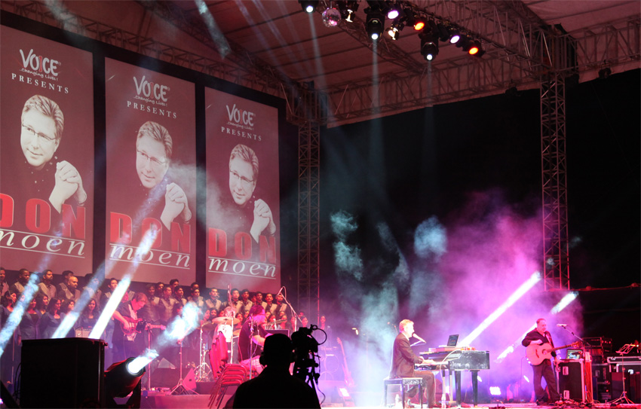
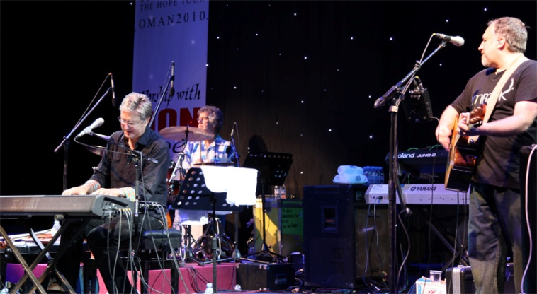
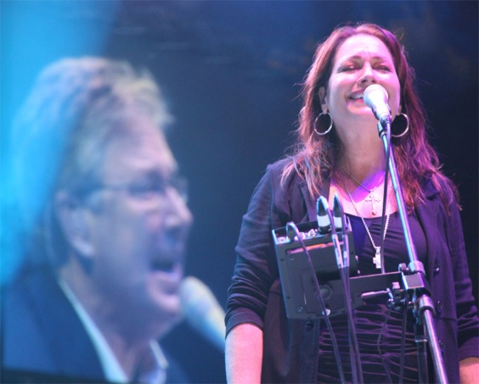
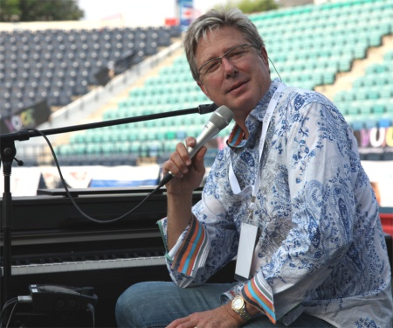
Don Moen – using myMix since 2010 all over the world
8 myMix for Don and the band

Slide 8
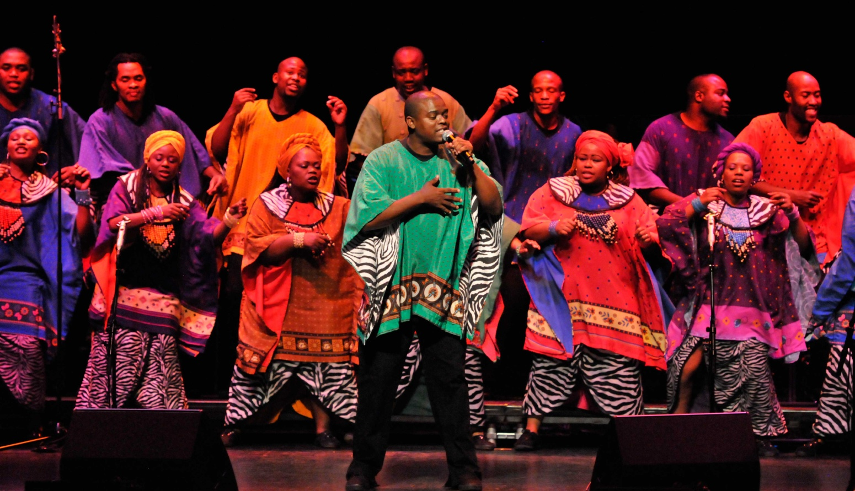
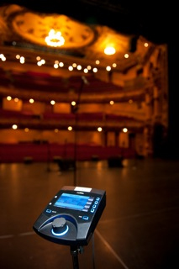
Soweto Gospel Choir – using myMix on world tour
1 IEX16, 6 myMix for the band

Slide 9
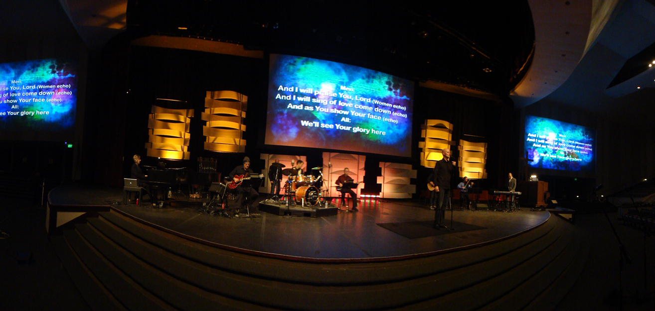

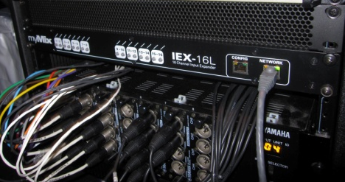
Grace Church Eden Prairie, Minnesota, USA
2 IEX16L and 12 myMix for the multiple praise bands (50+ musicians in total)

Slide 10




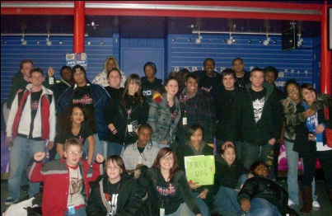
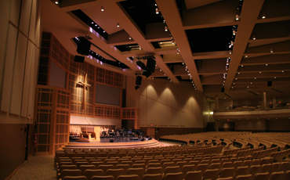
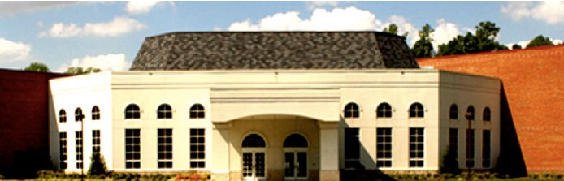

Ridgeview Community Church
Franklin, Tennessee, USA
Installation Type: Portable
(5) myMix
(1) IEX-16L
(1) Connect8
International Family Church
North Reading, Massachusetts, USA
Installation Type: Fixed
(5) myMix
(2) IEX-16L
(1) Power12
Calvary Chapel
Carson City, Nevada, USA
Installation Type: Fixed
(9) myMix
(2) IEX-16L
(1) Power12
Cornerstone Community Church
Concord, New Hampshire, USA
Installation Type: Fixed
(5) myMix
(1) IEX-16L
(1) Power8
Grace and Truth Bible Fellowship
Warren, Michigan, USA
Installation Type: Portable
(8) myMix
(1) IEX-16L
(1) Power12
Wheaton Bible College
Wheaton, Illinois, USA
Installation Type: Fixed
(8) myMix
(1) IEX-16L
(1) Power24
Sovereign Grace Church
Chesapeake, Virginia, USA
Installation Type: Fixed
(12) myMix
(4) IEX-16L
(1) Power12

Slide 11
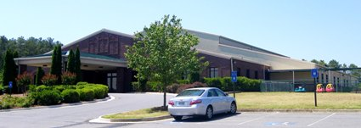

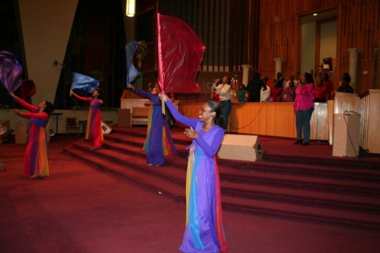

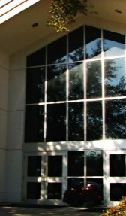
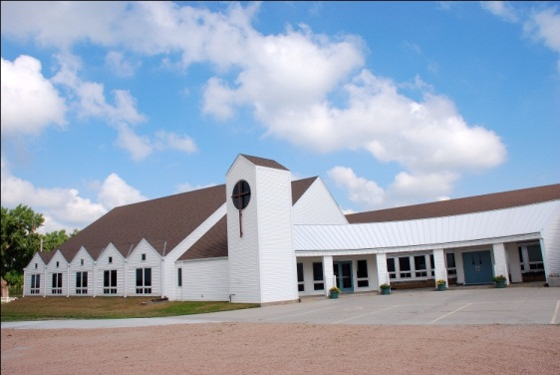


Fortified Hills Baptist Church
Dallas, Georgia, USA
Installation Type: Fixed
(5) myMix
(1) IEX-16L
(1) Power8
Holy Trinity Lutheran Church
Marietta, Georgia, USA
Installation Type: Fixed
(5) myMix
(1) IEX-16L
(1) Power8
Word Of Faith
Atlanta, Georgia, USA
Installation Type: Fixed
(5) myMix
(1) IEX-16L
(1) Power8
Element Church
Wentzville, Missouri, USA
Installation Type: Fixed
(6) myMix
(1) IEX-16L
(1) Power12
Stetson Baptist Church
DeLand, Florida, USA
Installation Type: Fixed
(6) myMix
(1) IEX-16L
(1) Power8
Monroe Evangelical Free Church
Phillips, Nebraska, USA
Installation Type: Fixed
(8) myMix
(1) IEX-16L
(1) Power12
Freedom Church
Lebanon, Indiana, USA
Installation Type: Fixed
(6) myMix
(1) IEX-16L
(1) Power8

Slide 12
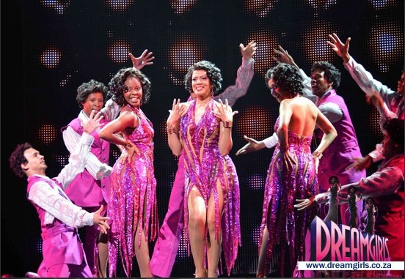
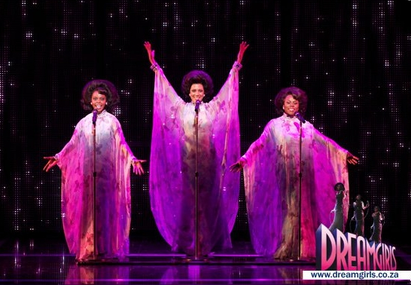
Musical Dream Girls Tour in South Africa
1 IEX16L and 12 myMix for the In-Ear Monitoring of the band

Slide 13
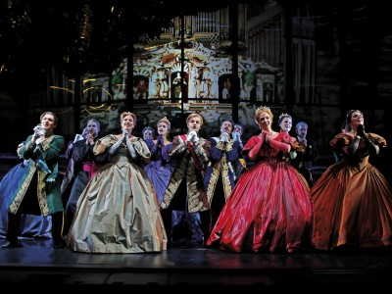
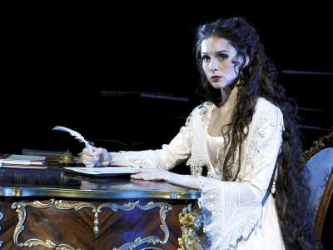
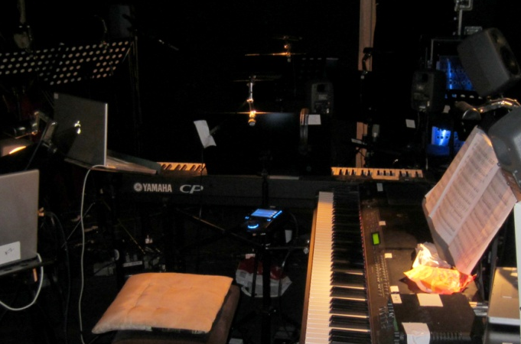
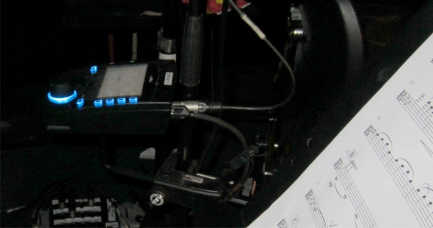
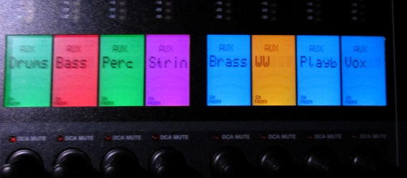
Musical Elisabeth Tour in Germany 2011/12
1 IEX16L and 15 myMix for the orchestra and conductor

Slide 14


“I wouldn't tour with any other system."
--Don Moen, Praise and Worship Artist

Slide 15


“We chose myMix because it has the best sound quality.”
--Brendan Prout, Worship Leader, Community Bible Church, San Diego

Slide 16

“myMix makes having a great sounding mix in the musicians’ headphones possible—both in the studio and on tour.”
--Chuck Harris, Tech Engineer for
Don Moen

Slide 17
“The recording feature takes you to a whole different level and options in your approach to music.”
--Felipe Moreno, piano player, Salvation Army Church in Minneapolis, MN

Slide 18

“As a studio engineer, you forget myMix is there because it’s just doing its thing and everyone is taking care of their own business. Nobody is talking or complaining about their headphone mix because everyone is happy!”
--Darren Rust, Owner Skyland Studios

Slide 19
“No more cranky musicians because of bad sound!”
--Felipe Moreno, piano player, Salvation Army Church in Minneapolis, MN

Slide 20
“My friend and fellow musician, Paul Peterson introduced me to myMix and I thought it was the coolest new product that I have seen in a very long time. I use myMix in my studio. The fact that all the musicians can dial in their own mix is incredible. I am very picky when it comes to how things sound, and I’m incredible impressed with how true and transparent myMix is."
--Oliver Leiber, producer& songwriter

Slide 21
“Every set of phones are different and to be able to dial in an EQ curve that fits the phones is a Godsend.”
--Darren Rust, Owner Skyland Studios

Slide 22
“We are a diverse church with many different services and musicians. We may have up to 5 drummers in one week. Each musician can call up his profile and not have to mess with any other settings.”
--David Freeman, Worship Leader
Willowbrook Baptist, Huntsville, AL

Slide 23
“myMix has allowed us to remove thousands of watts of wedge monitors from the stage and has cleaned up the house sound immensely, so the FOH sound guy is thrilled.”
--Brendan Prout, Worship Leader, Community Bible Church, San Diego

Slide 24
“myMix has definitely improved our performance. There simply is no comparison to what we were doing before and now.”
--David Freeman, Worship Leader
Willowbrook Baptist, Huntsville, AL

Slide 25


Personal Monitor Mixing is becoming
its own product category

Slide 26
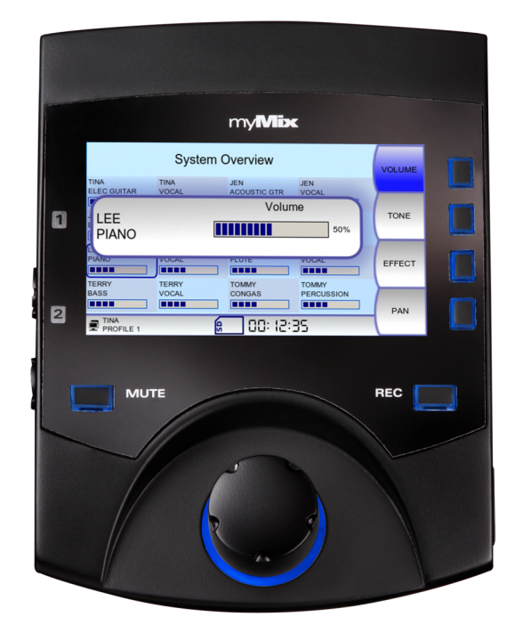
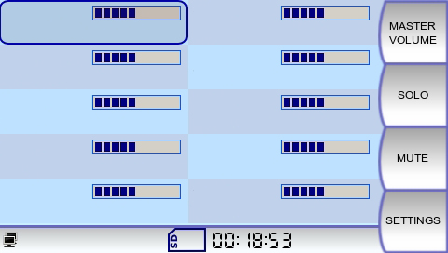
Intuitive Bedienoberfläche
Patentiert!!
BASS
E GUITAR
PHIL
DRUMS
AC GUITAR
KEYBOARD
PIANO
Name - keine Nummern
Großer Drehknopf
Helles LCD Display mit allen Kanälen
Automatische Speicherung
VOCAL John
VOCAL Tom
VOCAL Bill
VOCAL Susan
Notes:
I am going to give a quick overview of the features of myMix and later we will go into more detail about how the features add real benefits.

Slide 27
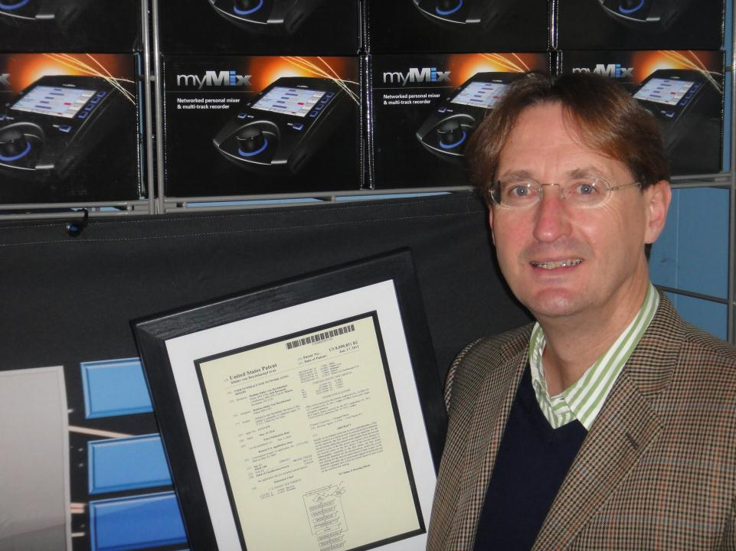
US Patent for user interface

Slide 28
Dezentrales, Netzwerkfähifges Digitales Mischpult System
Intuitive Bedienung
Integriert oder eigenständig
Lokale Netzwerk Ein- und Ausgänge
Hervorragende Audio Qualität
Zusätzliche Eingänge – analog oder digital
Voll skalierbar – 1 , 2 … hunderte
Mehrspur -Aufnahme und Abspiele Möglichkeit (max 16 Spuren) Identifizierung der Kanäle nach MAC Adresse und Namen (neuer Name = neuer Kanal)!

Slide 29

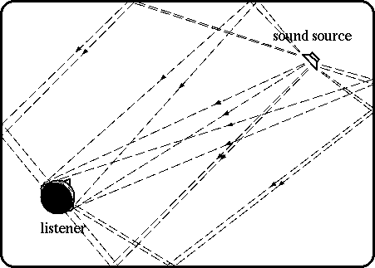
3-Dimensionaler Sound
Die internen Stereo Effekte erlauben insbesondere bei In-Ear Betrieb ein dreidimensionales Klangbild

Slide 30
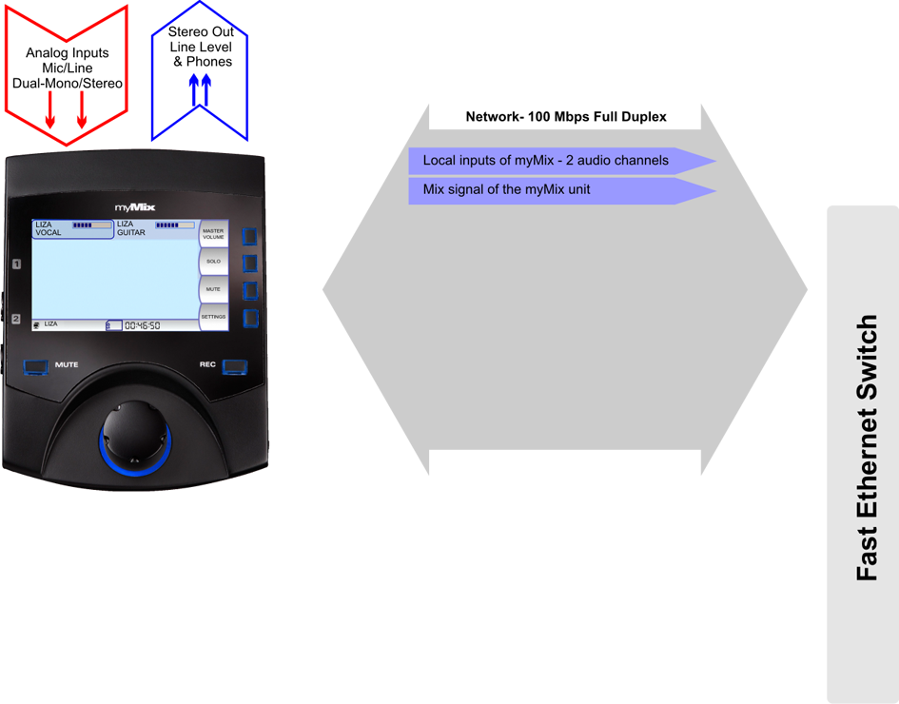
Inputs
Mix Out
100Mbps Ethernet CAT5
Die lokalen Eingänge können zum Netzwerk geschickt werden (Duaöl Mpono oder Stereo, ebenso der Stereo-Mix
Notes:
Example using Y-cable

Slide 31
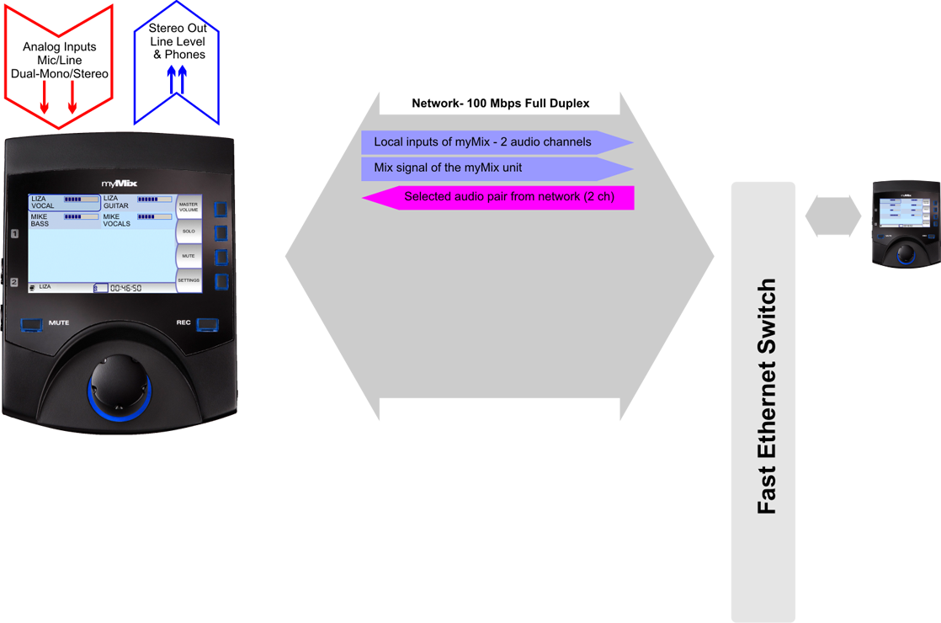
Inputs
Mix Out
100Mbps Ethernet CAT5
Die Signale werden automatisch erkannt und mit Namen angezeigt
Notes:
Example using Y-cable

Slide 32
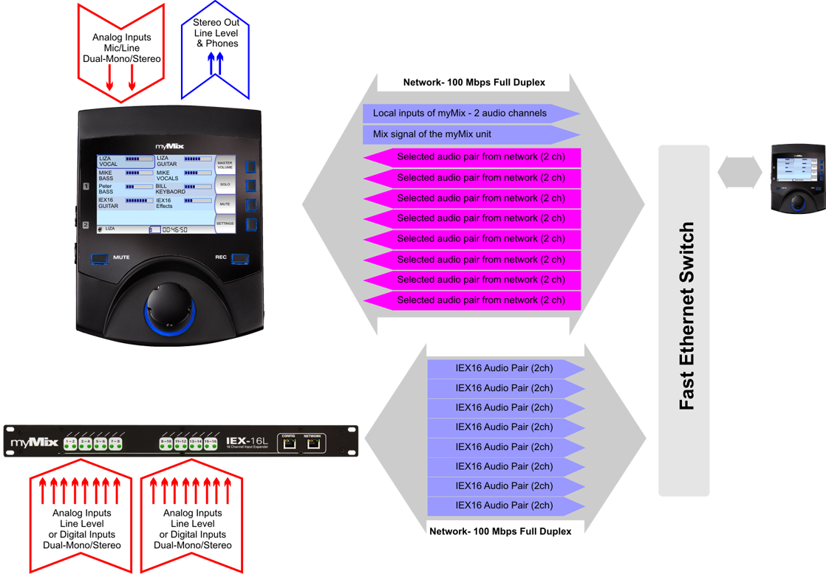
Inputs
Mix Out
100Mbps Ethernet CAT5
16 Inputs: Analog/Digital
IEX16 für 16 zusätzliche Audio signale im Netzwerk

Slide 33

Inputs
Mix Out
100Mbps Ethernet CAT5
16 Inputs: Analog/Digital
Offenes System – nahezu unbegrenzt

Slide 34
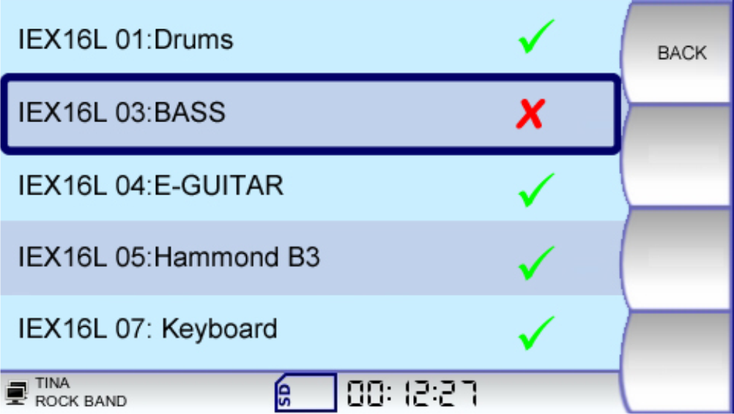
Inputs
Mix Out
Jeder myMix kann Signale einzeln an bzw. abwählen.
Max 16 Monosignale , oder 8 Stere, oder jede Kombination dazwischen (aus 8 Signalpaaren).
Notes:
Example using Y-cable

Slide 35
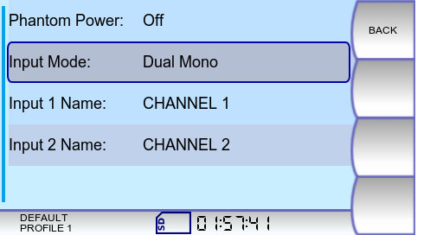
Inputs
Mix Out
Die MAC Adresse des Senders und der alphanumerische Kanalname werden zur Identifizierung verwendet. Neuer Name = Neuer Kanal!
Notes:
Example using Y-cable

Slide 36
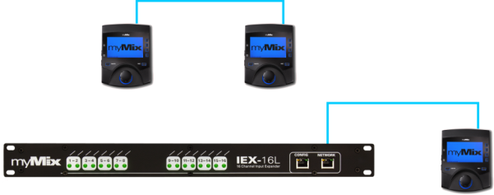
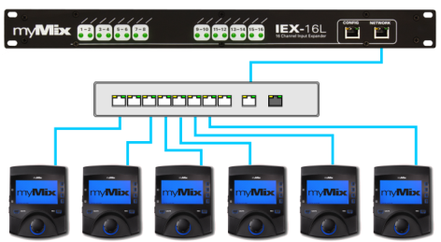
myMix Netzwerke-
Absolut dezentral
Das einfachste System: 2 myMix,
Oder ein IEX16 und ein myMix
Oder 8 myMix 1 IEX, ……………
Notes:
Example using Y-cable

Slide 37
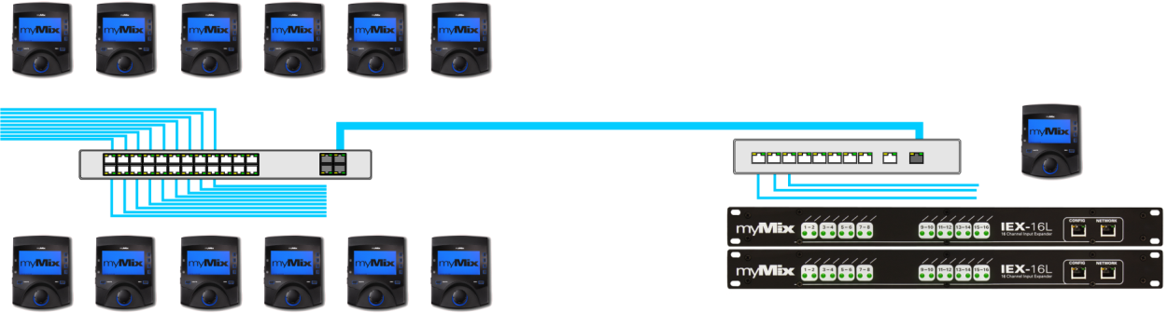
myMix Netzwerke
Verbindung von „myMix Switches“ über Gigaboit Uplink ports
- Auch in Hausnetze integrierbar -
Notes:
Example using Y-cable

Slide 38
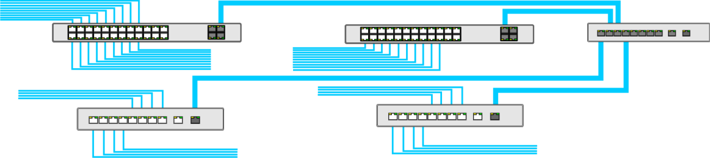
myMix Netzwerke
Mehrere Switches werden über einen GB Switch sternförmig verbunden –
Auch in Hausnetzwerke integrierbar.
Notes:
Example using Y-cable

Slide 39



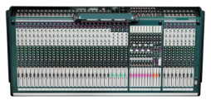





myMix System – Integriert oder Eigenständig
Bühne-
Personal Monitoring &Recording
Large System with IEX-16L,
Managed Switches, Console
Übungsraum, Konferenz Bandporbe,
Unmanaged Switch, Kein Mischpult-
Personal Mix & Recording
Einzelgerät-
Playback or play along recodings or preproduced multi-track files for rehearsing
Notes:
Here an overview what you can do with all the same myMix.

Slide 40

myMix stellt beide Hirnseiten zufrieden
Intuitive Bedienung – Namen Statt Zahlen
Lässt den Musiker in seiner Kreativzone
Kreativität
Phantasie
Kunst & Musik
Rhythmus
Intuition
Emotion
Zahlen
Sequenzen
Logik
Mathematik
Reihen
Analytik
Rechte Hirnseite
Linke Hirnseite
Notes:
Creativity and emotion are on the other brain side than numbers, math and logic. myMix is designed to keep the operators (musicians) in their creative mind set.
And musicians wonder why the sound guy can’t comprehend the vibe they require on stage to really dig deep creatively.
It’s because they operate from different sides of the brain that, in many cases, lead to completely opposing perspectives and understanding of the situation.

Slide 41





First of its kind, decentralized solutions-based personal monitor mixer
Patented, intuitive , easy- to-use, user interface with large LCD screen
Allows the musician to be in control of the mix and lets the engineer concentrate on the house sound.
Works independently as its own unit or can be connected to unlimited myMix on the nework. use one, two, or as many myMix as you need !
Connects to the FOH via input expander, (digital and analogue)
Local network inputs (2 )and outputs (2) on each mymix:
Simple connection via cat 5 cables to a Fast Ethernet Switch
Impecable audio quality
Built in choices of stereo effects (reverbs, delay) a 3D sound image
Send mix over network, so others can listen (e.g. engineer)
Instant multitrack recording onto SD card as timestamped WAV file format (24 –bit/48kHz)
Playback or play along and remix multitrack sessions
Talkback intercom available over network
Each myMix can select and mix up to 16 audio channels ,and adjust in channel volume, tone, effect send, solo mute and pan
All settings automatically stored in up to 20 different profile; allows for inter- changability beween different users (recall)
Works with in-ear, headphones or wedges
Ships with power supply and 5/8” metal microphone stand adapter
myMix setzt die Messlatte und wird der neue Standard!

Slide 42

MADI-IN
Ein IEX16L-A für jeweils 16 Kanäle
Notes:
So what is myMix. It is a ...........
The way you know consoles is that all signals come centralized into the mixer. You change the signal and send it out again.
With myMix each mixer has all information about everything and therefore there is no centralized system.

Slide 43


bis maximal 64 aus dem MADI Signal
Notes:
So what is myMix. It is a ...........
The way you know consoles is that all signals come centralized into the mixer. You change the signal and send it out again.
With myMix each mixer has all information about everything and therefore there is no centralized system.

Slide 44

Auch Dante zu myMix
Focusrite REDNET 3 – Dante to 32 ch ADAT
Notes:
So what is myMix. It is a ...........
The way you know consoles is that all signals come centralized into the mixer. You change the signal and send it out again.
With myMix each mixer has all information about everything and therefore there is no centralized system.

Slide 45

myMix CONTROL

Slide 46

myMix CONTROL-
Fernbedienung und Konfiguration – wired/wireless
myMix Plug Computer mit WiFi 802.11b/g
USB port für Speichermedien
Web Browser Interface – läuft auf jedem Compuer, Tablet, usw…
Backup/Download o Des Gesamten System oder einzelner Geräte
Individuelle Konfiguration und Fernbedienung von myMix und IEX16
Global Profile Change for myMix
Locking Menu – sperrt einzelne Parameter
Offline Editing

Slide 47




myMix CONTROL-
Configure and edit any parameter in the system
myMix in the System
Locking
Config myMix
IEX16 Configuration
Web Browser Interface - independent

Slide 48


Slide 49









myMix - vielseitige Anwendungsmöglichkeiten
Theater, Musical
Live Sound
Kirchen
Industrial
Übungräume
Rundfunk, Ü-Wagen
Musikschulen
Konferenztechnik
Studios

Slide 50


Theatres, Orchestras, Musicals

Slide 51


Slide 52


Slide 53

Intercom-Talkback System
Lokale Anwahl der geünschten Kanäle
Direktes Sporechen zu Einzelpersonen oder Gruppen
Einfache Bedienung- auch Nicht-Techniker
Ethernet- Netzwerk
(Audio auf VLAN2)

Slide 54

Musik Schulen
Ein Lehrer kann mehrere Schüler einzeln oder in der Gruppe abhören, die Schüler köbnen den Lehrer hören und sie könnenmiteinander einzeln kommunizieren. ((Intercom).
Play Along erlaubt das speilen mit Band/Ensemble auch solo zum Üben.
Mehrspur-Aufnahme auf Knopfdruck

Slide 55





myMix – Konferenztechnik , Hotels, Tagungszentren

Slide 56






14 line level signals from console to IEX-16L
Lokale Eingänge pro Raum.
Room1
Room 2
Room 3
Main Ballroom Session
Room 4
Room 5
Room 6
Up to 16ch input from sound sources
Einspielen , Abhören, Kontrolliern
Room (n)
All
Sound Distribution

Slide 57


Simultan Übersetzungen

Slide 58


Slide 59








myMix Install
Notes:
Many places to use the intuitive UI and the networking capability of myMix.

Slide 60





Intercom and Listening System

Slide 61


myMix Install Version
Glass Panel – Custom Print

Slide 62

myMix Install – Desk Mount

Slide 63


myMix Install – Wall Mount

Slide 64


Slide 65


The myMix Demo Cases
A myMix system in a box:
DEMO8KIT
With 8 myMix
1 IEX16L (or IEX16L-A)
1 POWER8 Switch
Sturdy Case with cut foam inlet
DEMO10KIT
Same but 10“ deep case
With room for extra cabling (DB25 snakes, CAT5..), wheels and handle

