Slide 1
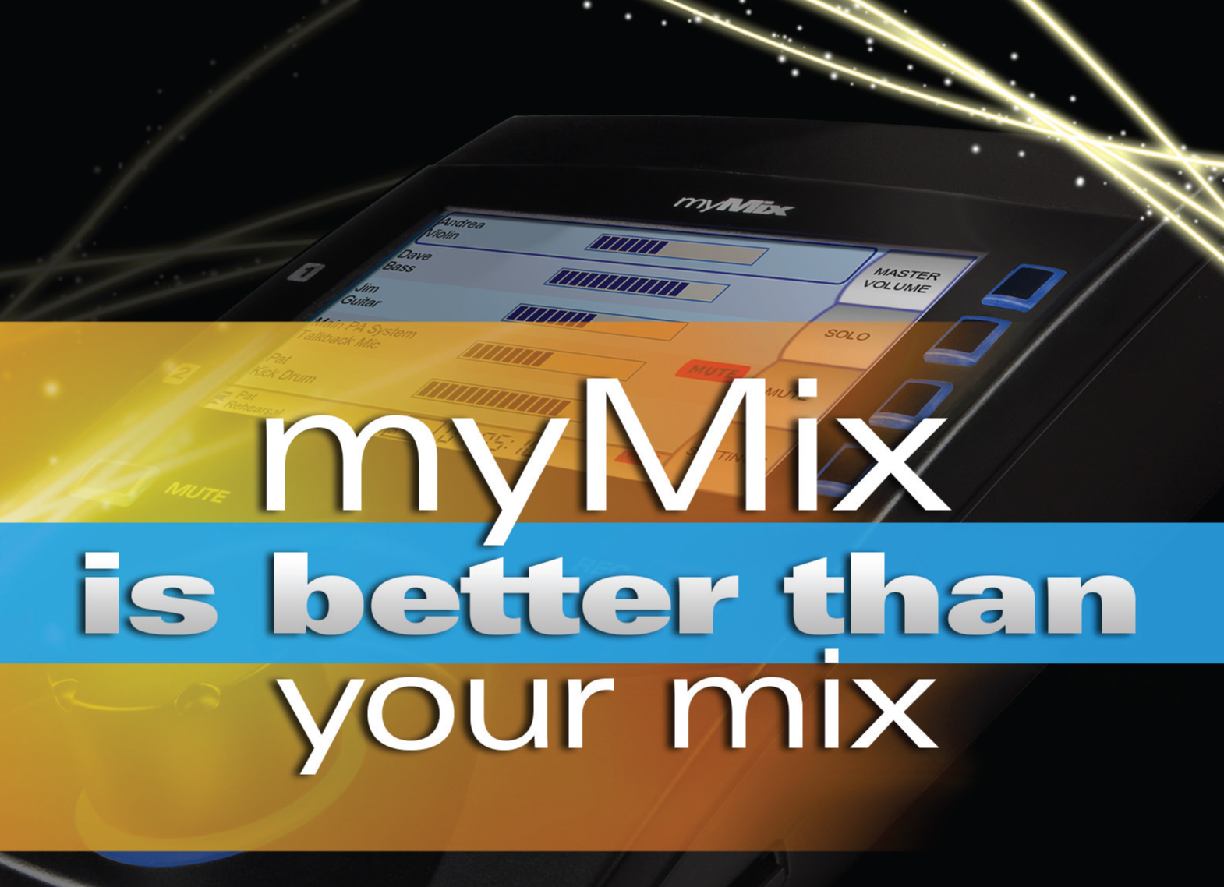
Update September 2013

Slide 2
Update September 2013
Recap of myMix Unique Customer Benefits
myMix Install
Potential New Products- Discussion
Local Activities – What can we do to boost your myMix sales?

Slide 3
Why is myMix better?
The only system with a Dezentralized Network Architecture
= there is no dedicated center unit
flexible number of audio network channels by adding units
myMix can be used stand alone
myMix devices can be used with common Ethernet Switches

Slide 4
Why is myMix better?
User firendly, flexible, versatile:
Intuitive UI with device and channel names
Multi Track Recording and Playback / Play Along
3D sound image due to individual stereo effects sends per channel
Stereo Mixes available as network channels
can work without or with any analogue or digital console

Slide 5

myMix is the only system with 7 different built-in stereo FX to create a 3D sound image for IEMs

Slide 6
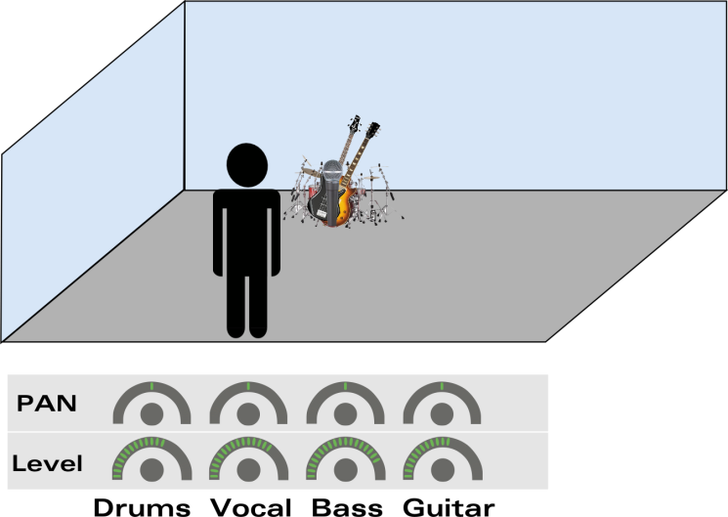
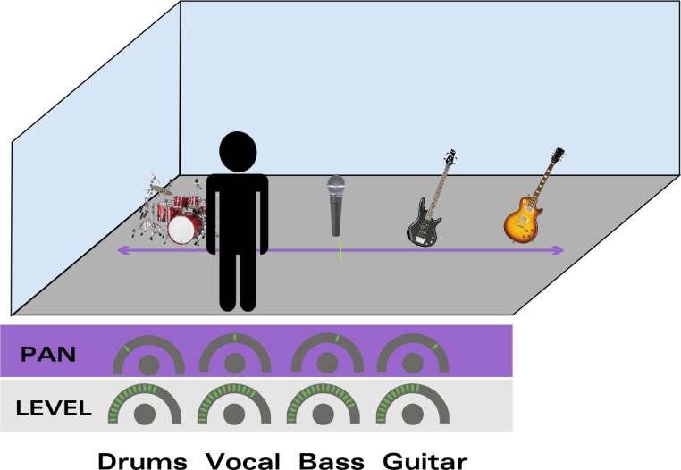
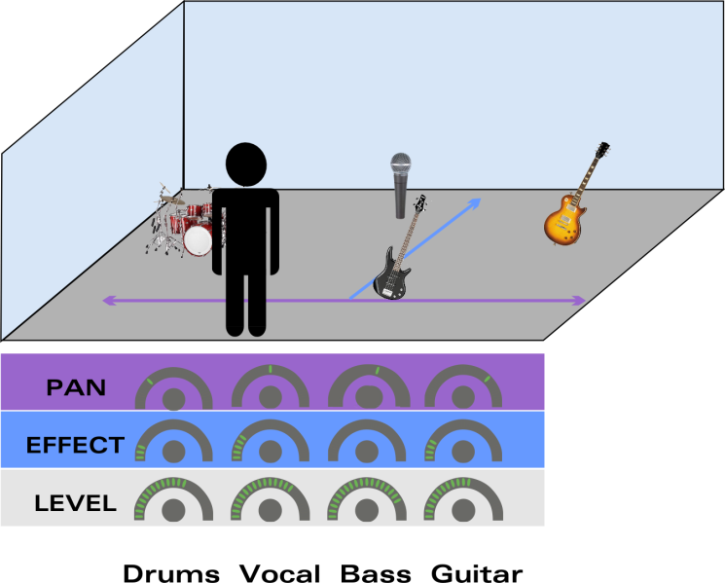
Adding stereo effects per channel = 3D
Each signal gets its own spatial information
=All voices / instruments early and easily differentiable
> changes in level, pitch or tune don’t require permanent correction
> No fatiguing (because the brain can work as usual)
> Great, sound with more fun for the musician
Mono 1D
PAN Stereo, 2D
Pan + StFX= 3D
Many musicians still listen to 1D (or 2D) mixes and are not aware of the consequences!
Notes:
Adding additional to the panning a room or reverb helps recreating a 3D sound image.
The voices and instruments are getting much more distinct and articulated.
Changes in level, pitch or tune don’t bother and necessary corrections are reduced dramatically.
A good stereo mix with some well defined stereo effects helps to differentiate greatly, which is the key to easy listening and getting in the flow.
And finally enjoy making music.

Slide 7

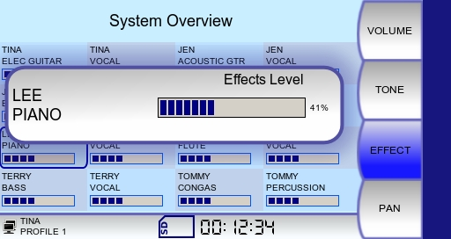
With myMix musicians enjoy a 3D sound image
stereo effect send level per channel
Choice of
3 rooms
3 reverbs
1 Delay
Also see the webinar on the website:
Video – Audio Files – Hand Out
http://www.mymixaudio.com/webinars/webinar-important-things-about-iems
Notes:
Not a toy – a must to rebuilt a 3D sound image!

Slide 8
myMix is the only system with built-in multi-track recording and playback
- Turn a practice into a rehearsal

Slide 9
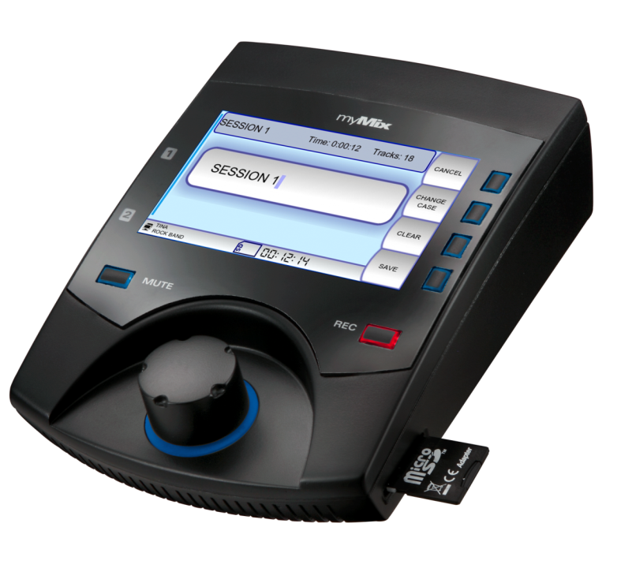
Multi-track Recording and Playback/Play Along
Record up to 18 tracks of 24bit, 48kHz time stamped broadcast .WAV audio on each myMix to SDHC cards.
Multi-track audio is tapped directly after the preamps on each unit
Channels 17 & 18 = YOUR stereo mix
Notes:
Just the other day i had a church on the phone anxiously awaiting a myMix demo because they had three new musicians which could have benefited perferctly from the recording function. They would have taken home a mymix with the session from the last three sundays and could have studied.

Slide 10
myMix is the only system that allows to select from hundreds * of audio channels
* 500 max

Slide 11
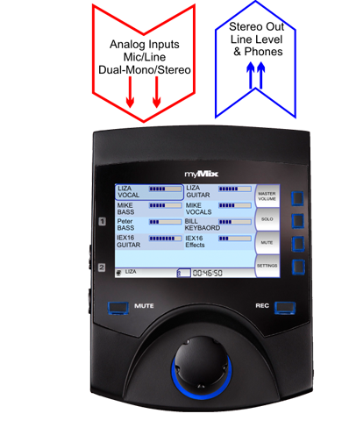
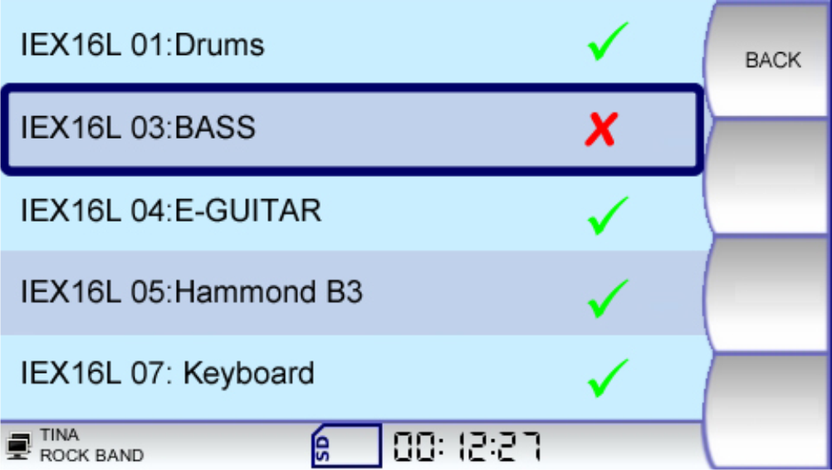
Inputs
Mix Out
Each myMix can have an individual selection of 8 input pairs (max 16 channels). In Remote Channel Select everybody can choose which signals (mono or stereo) are being used for the stereo mix. This can include any network signal, including the mix from another myMix device.
Notes:
Example using Y-cable

Slide 12
myMix is the only system that uses named audio channels in the UI

Slide 13
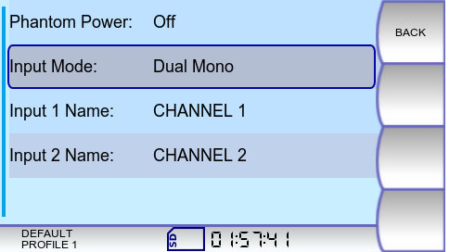
Inputs
Mix Out
The MAC address of the sending device and the channel name determin the identification on the network. Changing input names turns the same physical input into a new channel – which can be selected differently by others.
Notes:
Example using Y-cable

Slide 14
Only myMix allows a individual selection of the audio channels per unit-
As much or little detail as needed

Slide 15
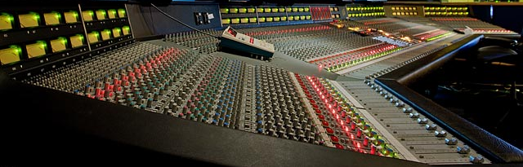
Too many channels to create a mix can easily overwhelm the musicians
Throwing 30,40 or more channels at the musicians and have them work along is not the way to do it.
Individual channels PLUS dedicated submixes
Get the musicians what they want – not less, but also not more
Notes:
Having 32 or more channels for each musician is overwhelming,
So the perfect diet for the musicians contains:
of course the own instrument and maybe others from the same „group“ should be available individually.
(all individaul vocals mics for a person singing)
Useful submices consolidating „other“ channels

Slide 16
See our webinar: http://www.mymixaudio.com/webinars/what-signals-to-send
Video – Handout

Slide 17
myMix is the only system you can use stand alone or integrated

Slide 18
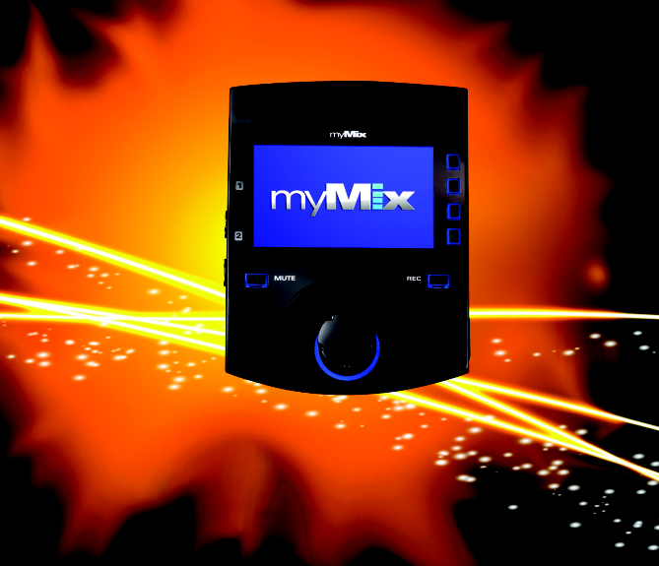
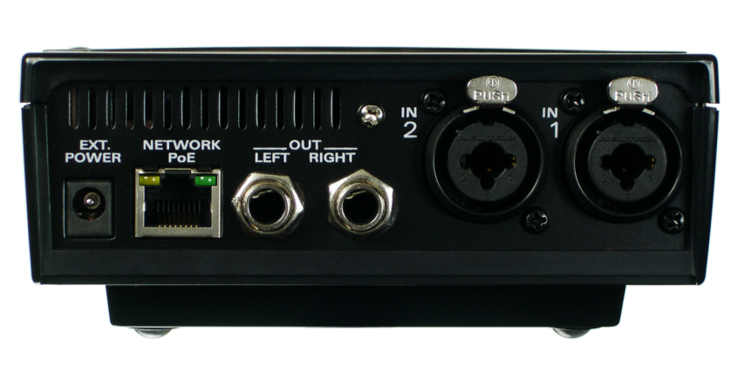
Network Outputs
Stereo Mix
Network Inputs
Local mic/line sources
Combo ¼” XLR/Jack, Mic/Line Input (Neutrik)
DC Power
RJ45 Ethernet Netzwork
Balanced ¼” TRS Jacks
Mix Output (Neutrik)

Slide 19
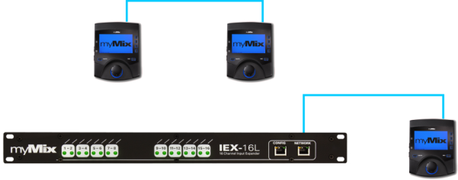
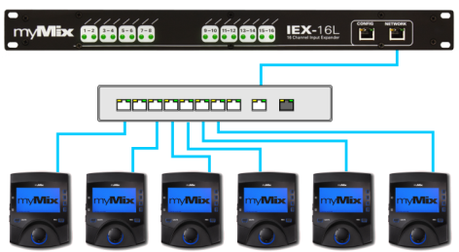
myMix Networks-
No proprietary master or center unit
The smallest system is to connect two myMix to each other, or one myMix to an IEX16 input expander.
The typical network uses an Fast Ethernet Switch – with IGMP snooping for >16 network channels
Notes:
Example using Y-cable

Slide 20
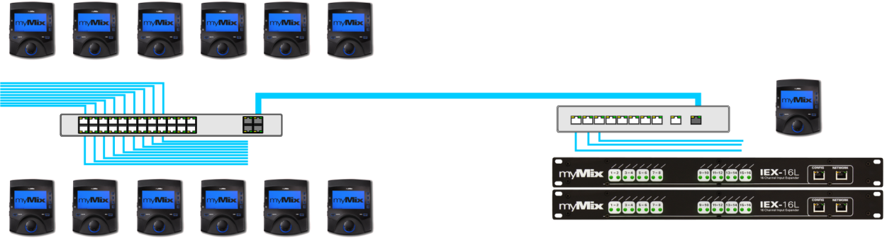
myMix Networks
Two switches can be linked via a GB uplink port.
Notes:
Example using Y-cable

Slide 21
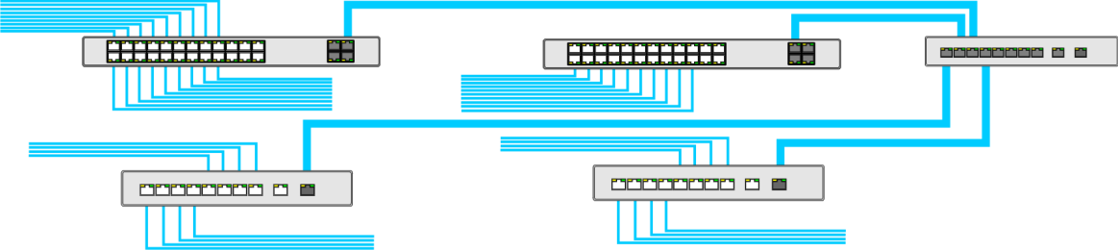
myMix Networks
System with multiple switches use one central GB switch
All opther switches are connected with a GB uplink port to the center switch.
Notes:
Example using Y-cable

Slide 22
myMix gives you more mileage than any other system

Slide 23



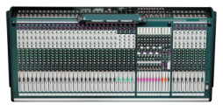





The Personal Mixer – Integrated or Stand Alone
On Stage-
Personal Monitoring &Recording
Large System with IEX-16L,
Managed Switches, Console
Rehearsal, Youth Group, or Session
Unmanaged Switch, No Console required-
Personal Mix & Recording
Single Unit-
Playback or play along recodings or preproduced multi-track files for rehearsing

Slide 24
myMix is the only systems that allows to put a stereo mix back on the network and have others listen to it

Slide 25
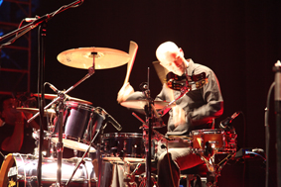
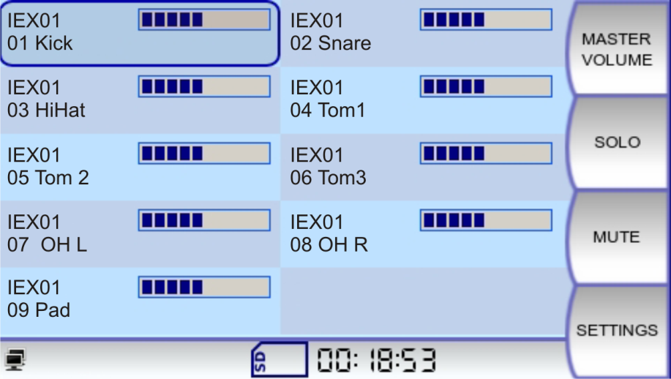
The drummer wants to create the drum submix himself?
Easy with myMix:
Use 1 myMix for all drum channels and send this mix to the network (Stereo Mix Drums)
Notes:
Drummer takes a second myMix:
1- create a submix of the drums with pan and FX
2- use a second myMix to get the drums plus 14 more channels on.

Slide 26
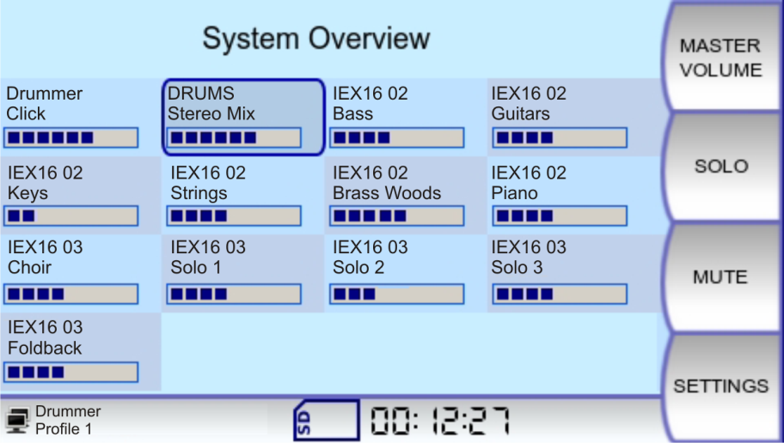
The drummer wants to create the drum submix himself?
Bring that mix to a 2nd myMix and add the other channels – up to 30 channels
9 drum mics + 12 others = 21
Notes:
Drummer takes a second myMix:
1- create a submix of the drums with pan and FX
2- use a second myMix to get the drums plus 14 more channels on.

Slide 27
myMix is the only systems that has a built-in intercom function
– peer to peer or peer to group(s)
Also see the tutorial video:
http://www.youtube.com/watch?v=IfhegjtrG1k&feature=youtu.be

Slide 28
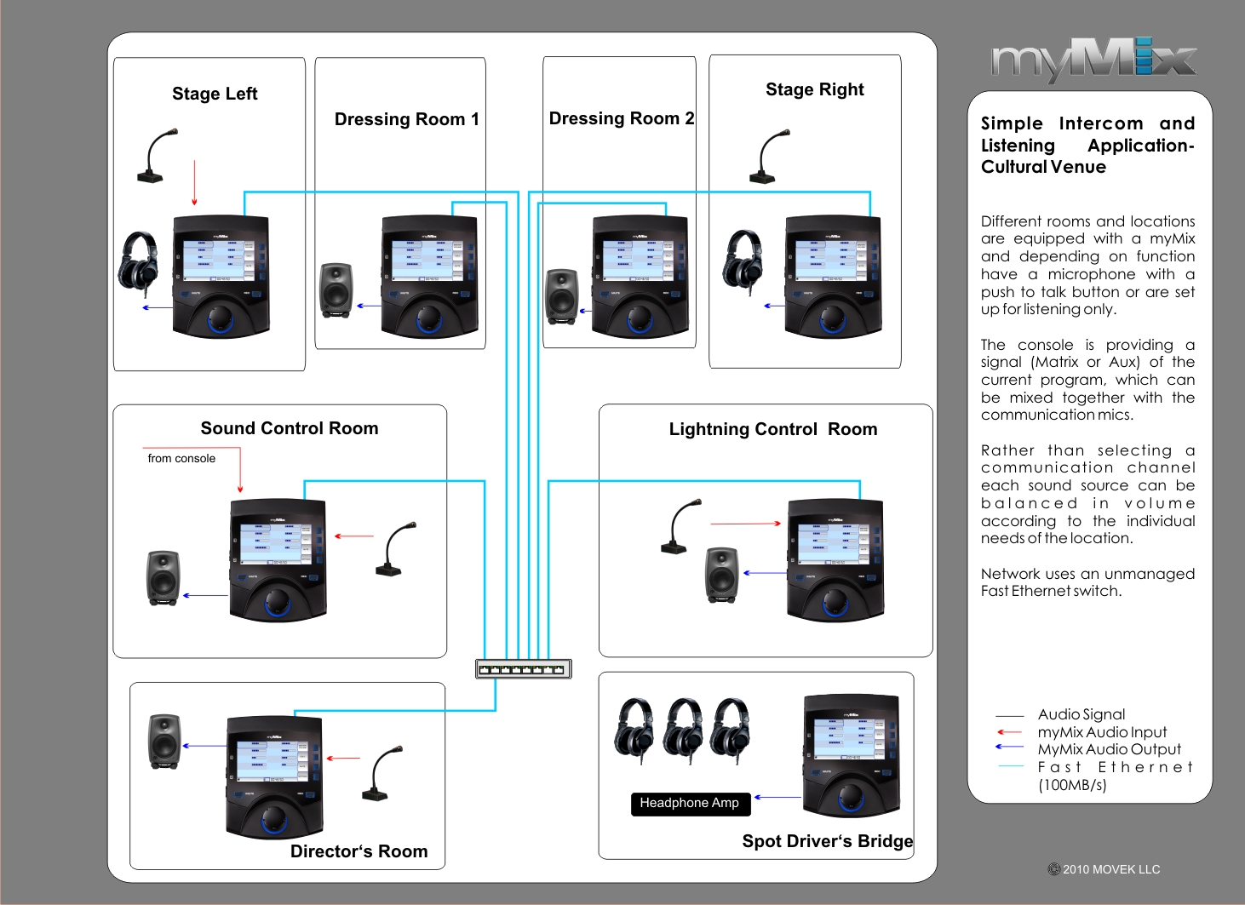
Intercom-Talkback System
Easy connection via CAT5
Switches can be used as repeaters
Optical cable can be used for even longer distances
Use different names for the local TB mic to talk to different people
Listeners can not only select but also adjust individual levels

Slide 29
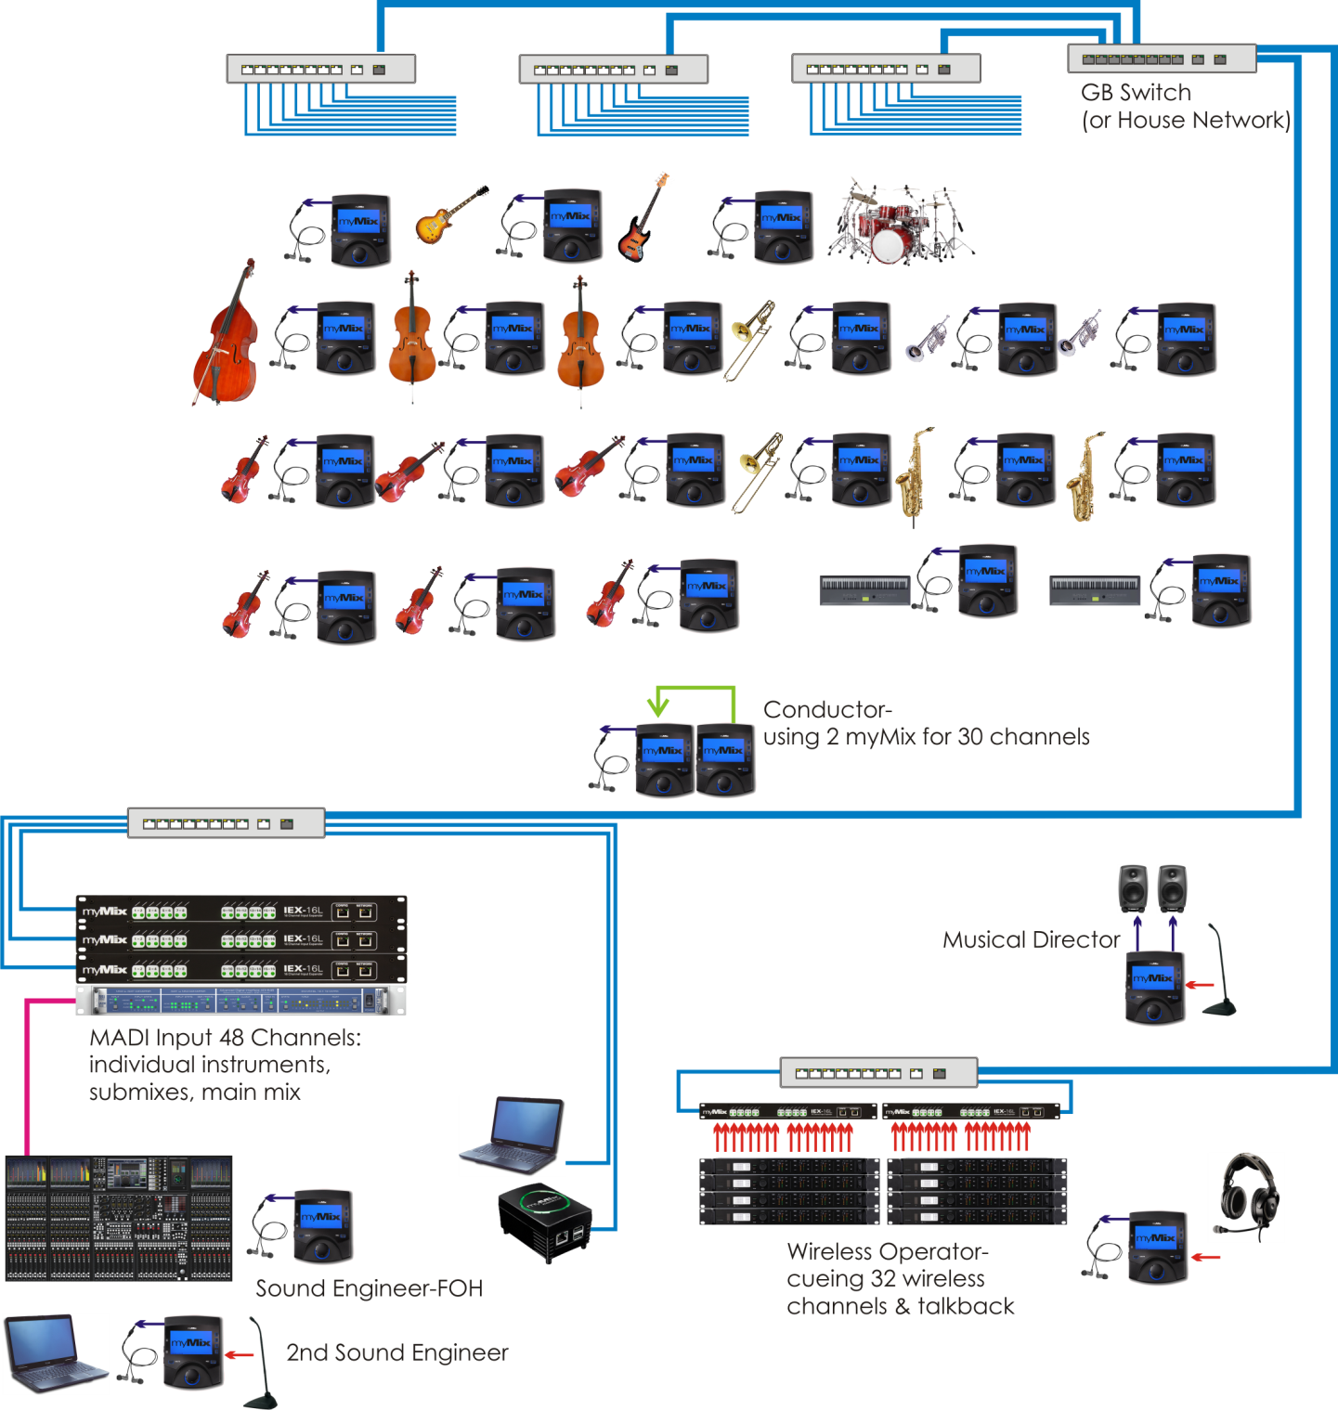
myMix for musicians
and crew:
-Personal Monitor
-Intercom
-Audio Monitor
-General Listening

Slide 30
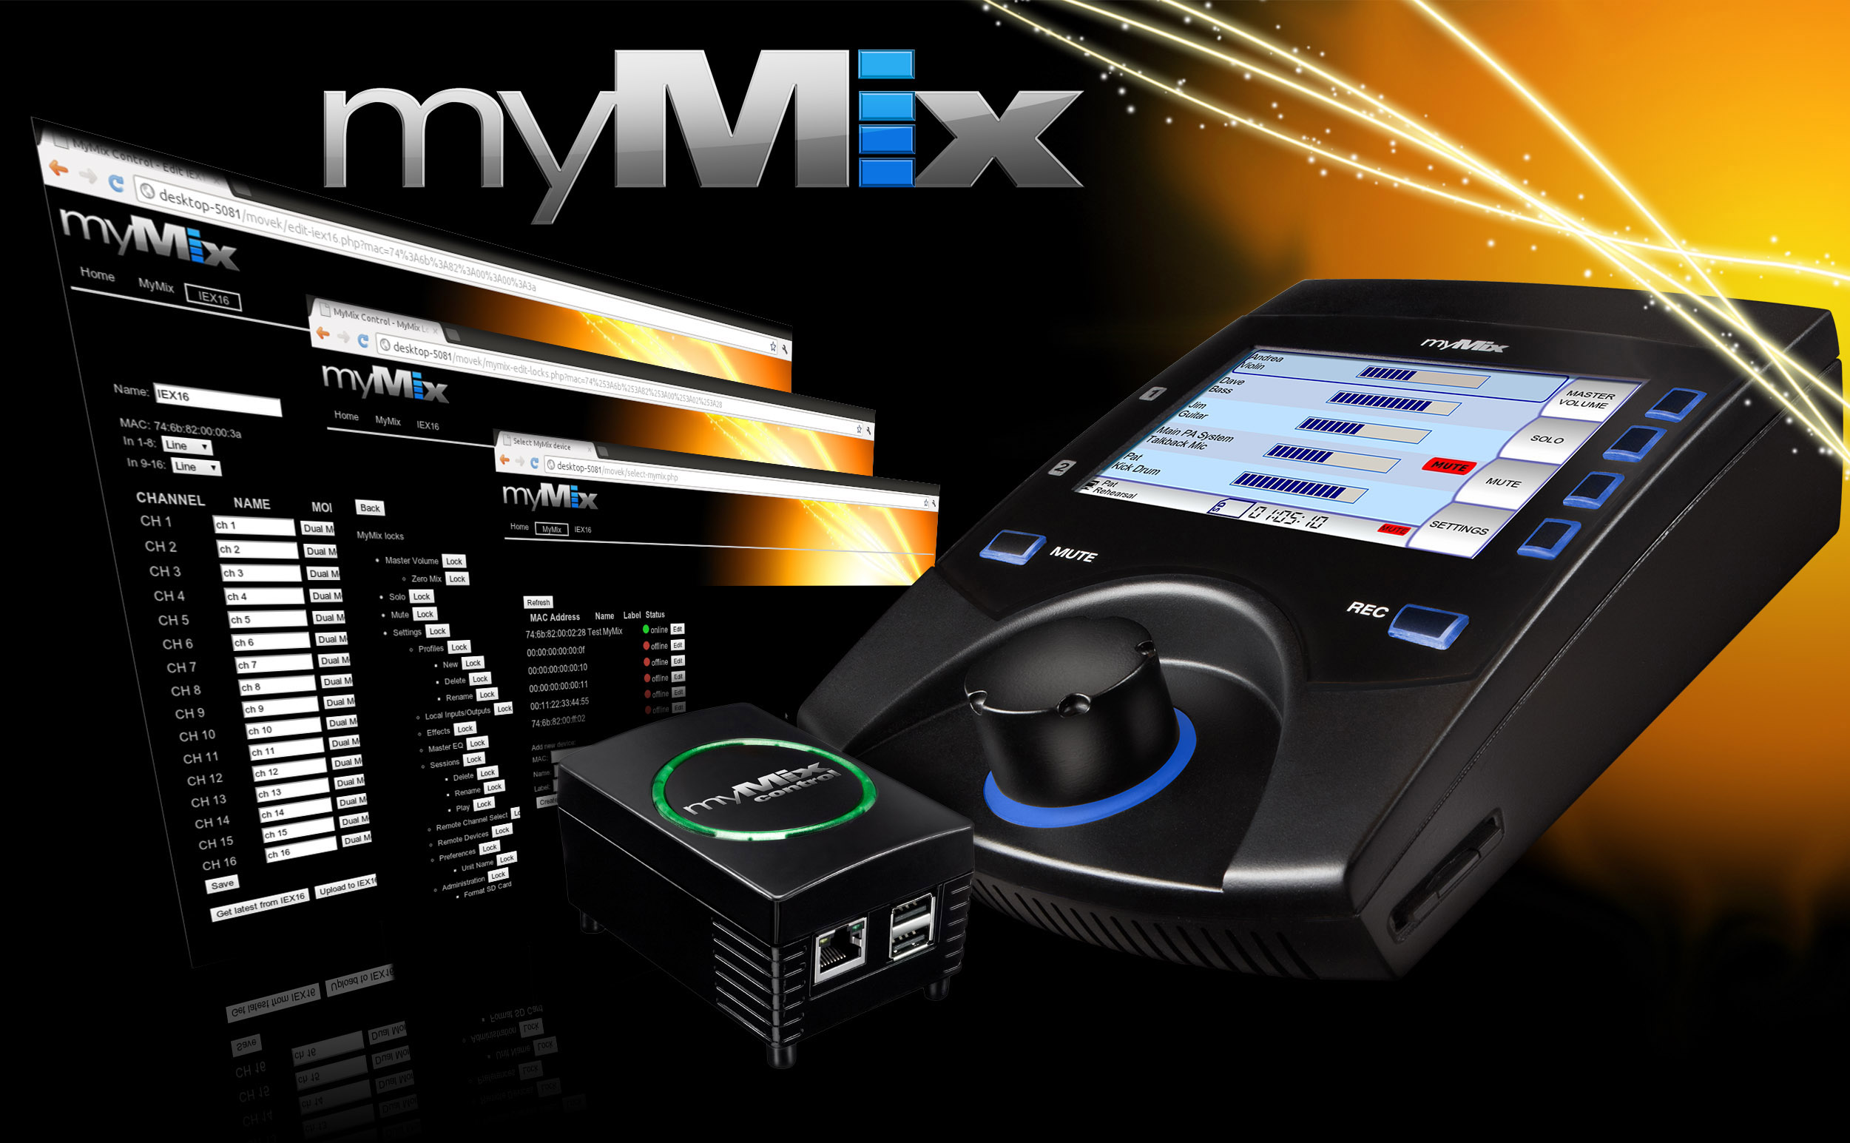
myMix CONTROL

Slide 31
myMix CONTROL allows the engineer to configure and support a myMix system in any detail – wired or wireless

Slide 32

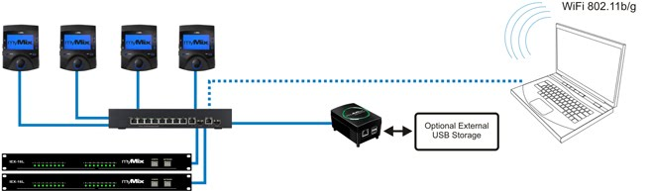
myMix Plug Computer with WiFi 802.11b/g access point
USB port for external data storage
Universal Web Browser Interface - No dedicated computer needed
Backup/Download of complete system settings
Individual Configuration and Editing of myMix and IEX16
Global Profile Change for myMix
Locking Menu with individual parameter locking per myMix
Offline Editing
Remote access to individual parameters including mixing

Slide 33
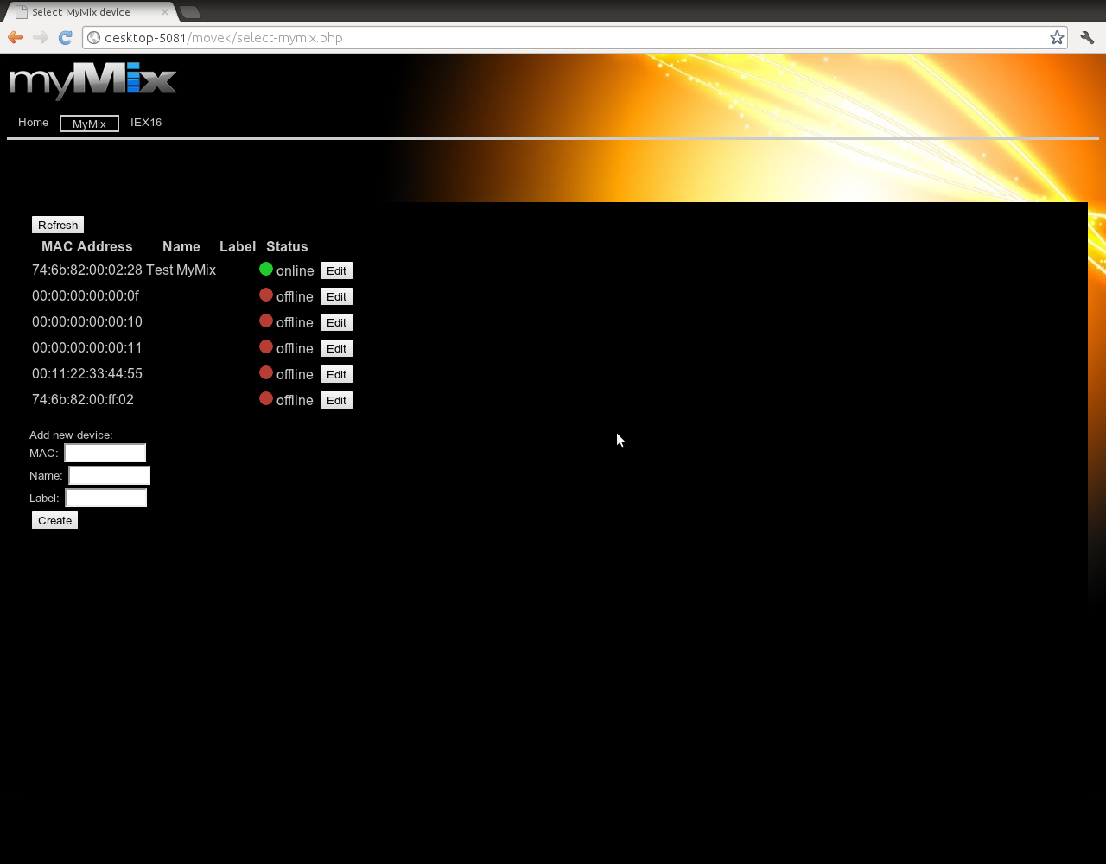
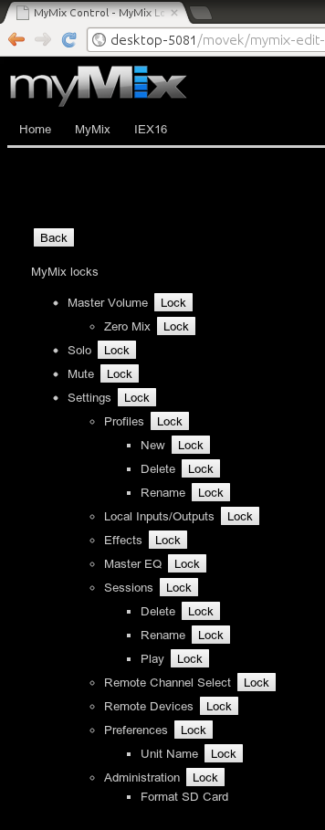
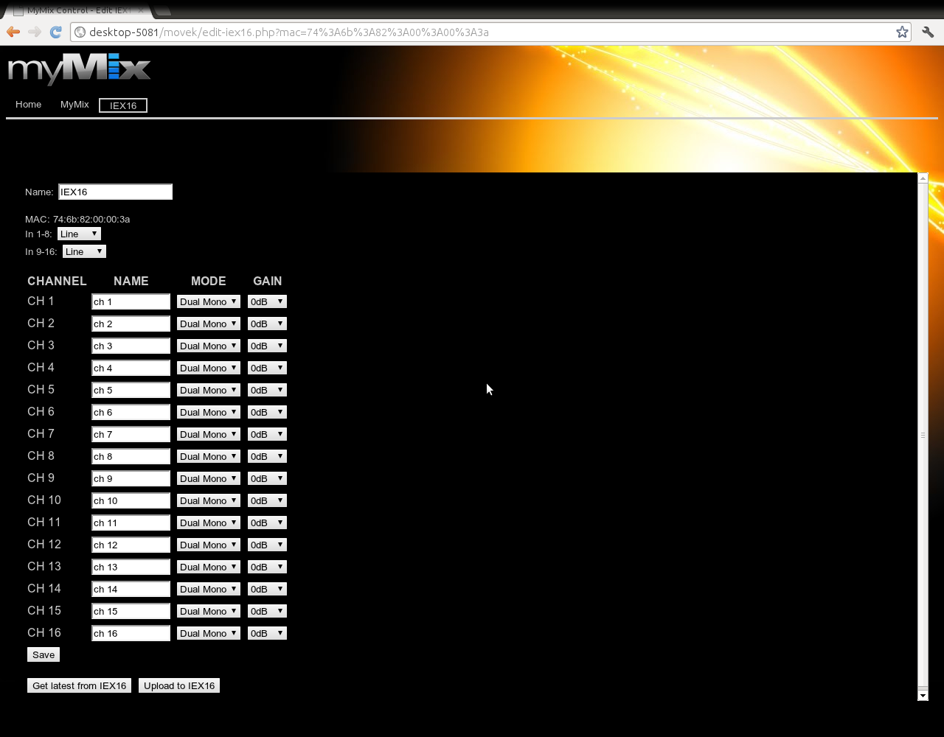
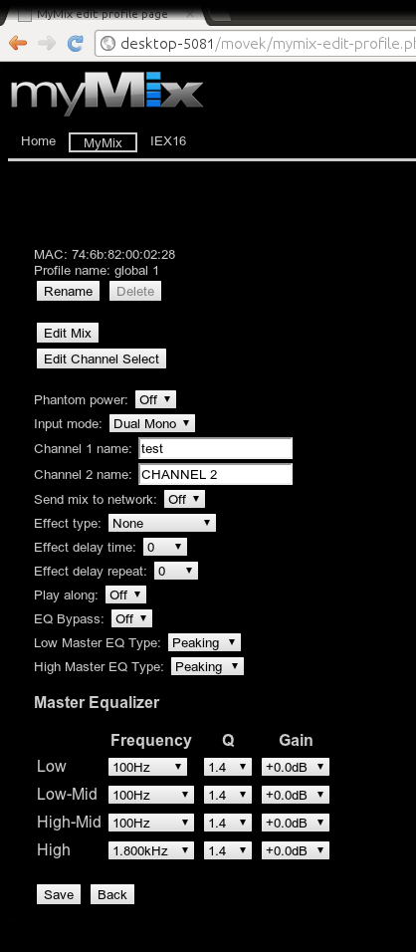
myMix CONTROL-
Configure and edit any parameter in the system
myMix in the System
Locking
Config myMix
IEX16 Configuration
Web Browser Interface - independent

Slide 34
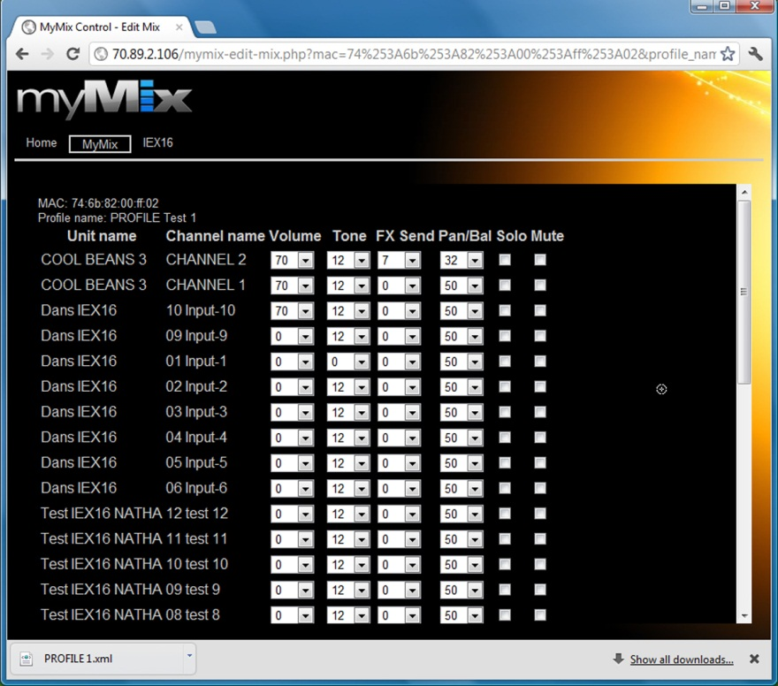

Slide 35
myMix = outstanding audio quality!
Our #1 selling feature!

Slide 36




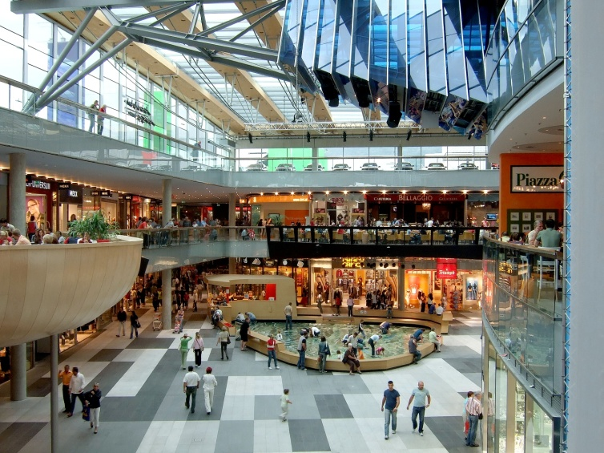
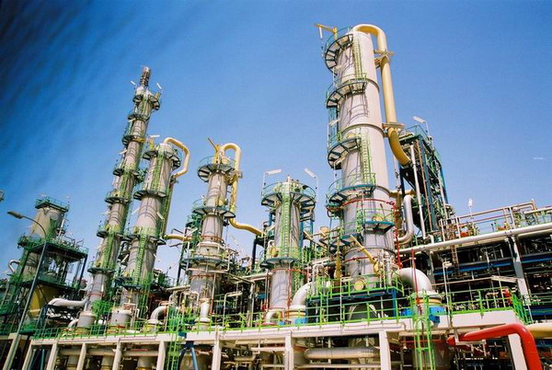
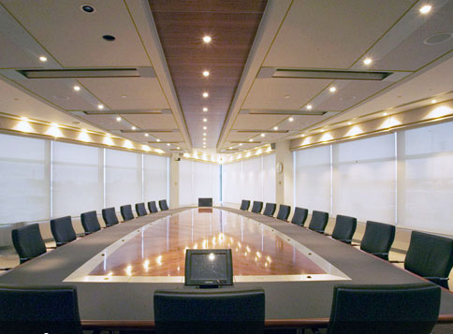

myMix Install
Notes:
Many places to use the intuitive UI and the networking capability of myMix.

Slide 37
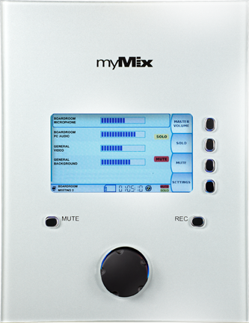
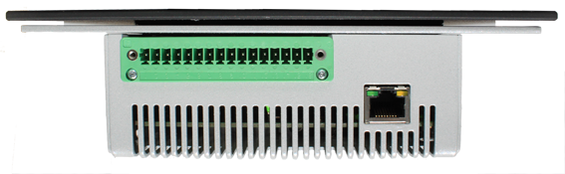

myMix INSTALL
Dedicated for Installation
In-Wall or Desk Top Mounting
Elegant Glass Front Panel
(can be customized in design)
Phoenix Connectors

Slide 38
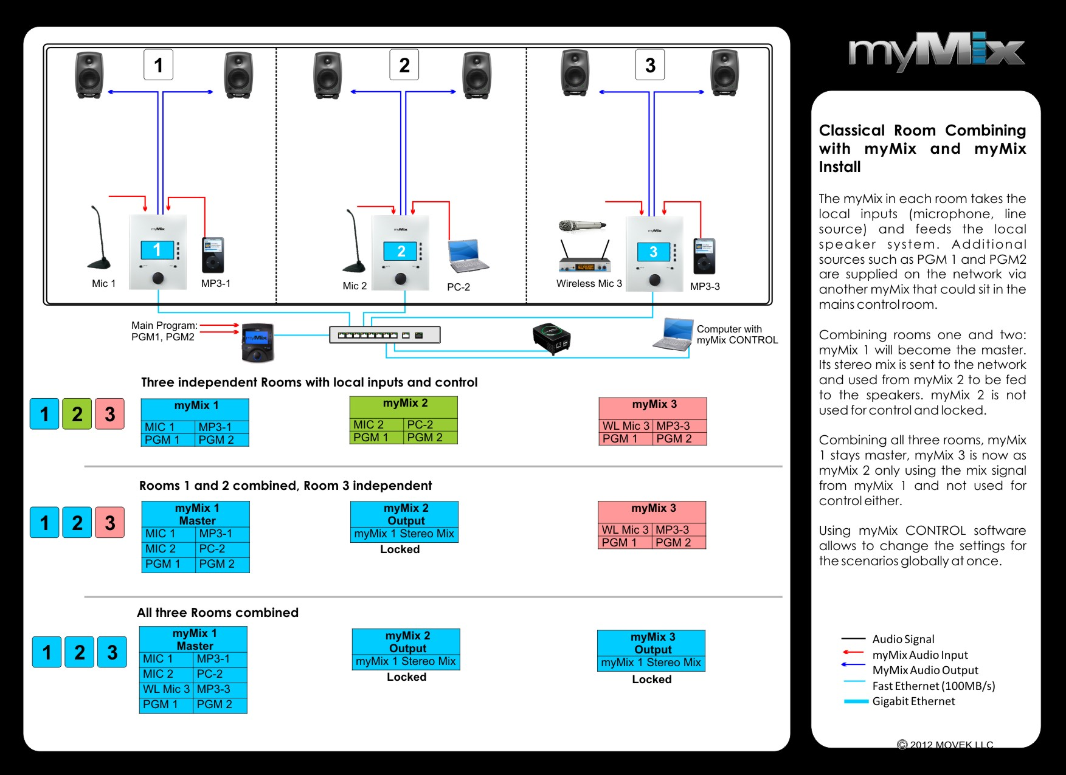

Slide 39
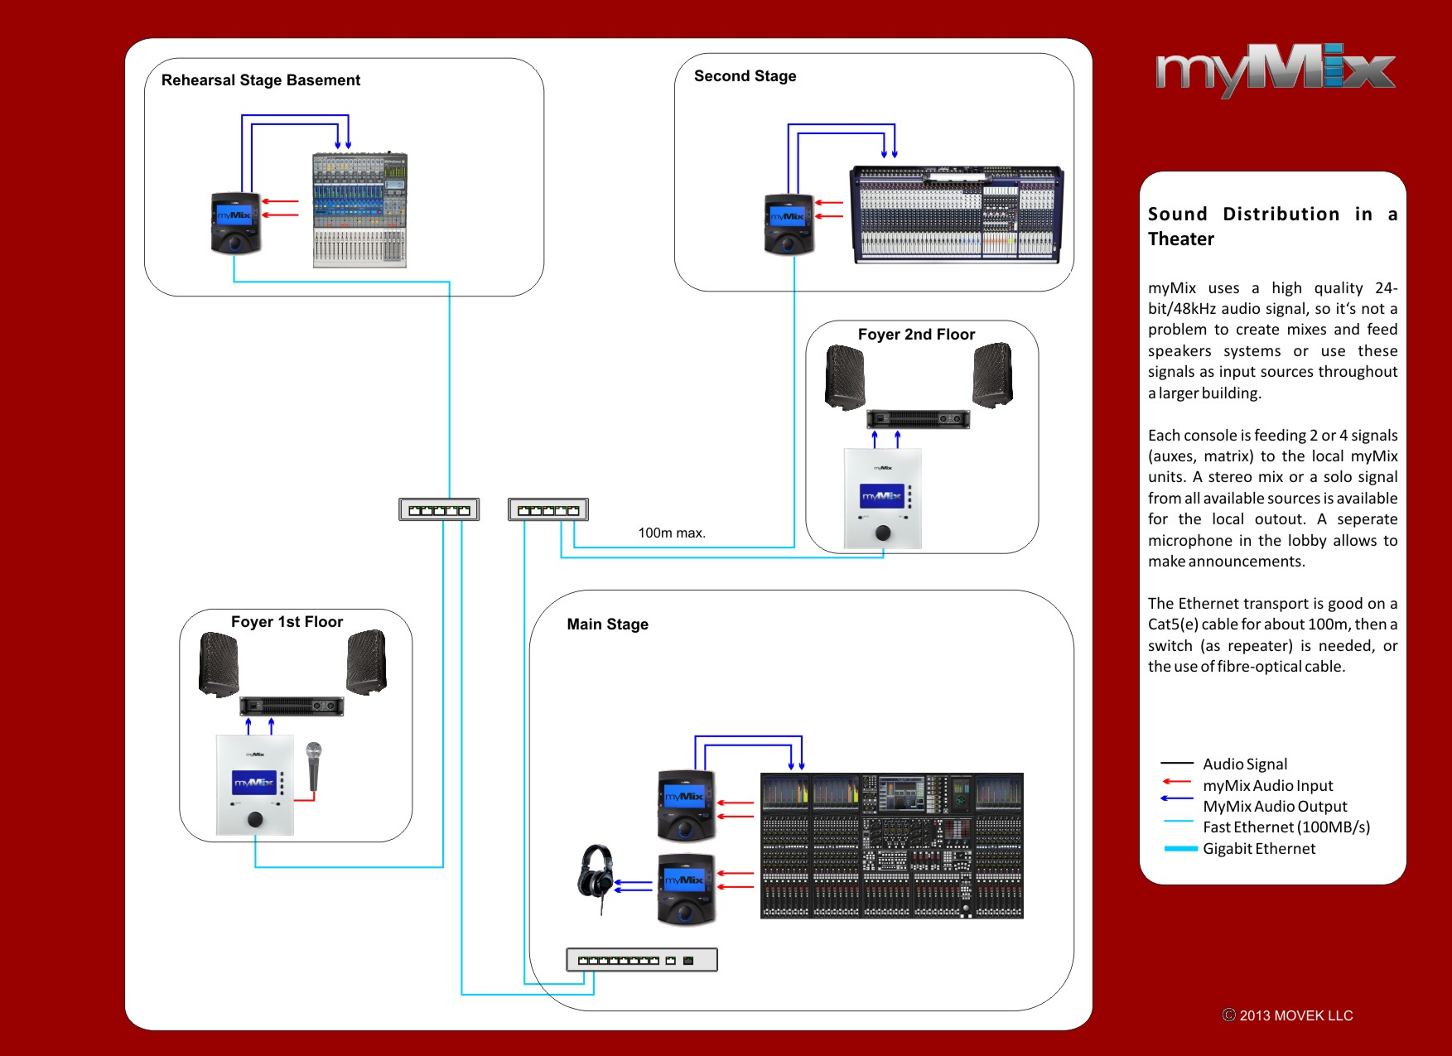

Slide 40
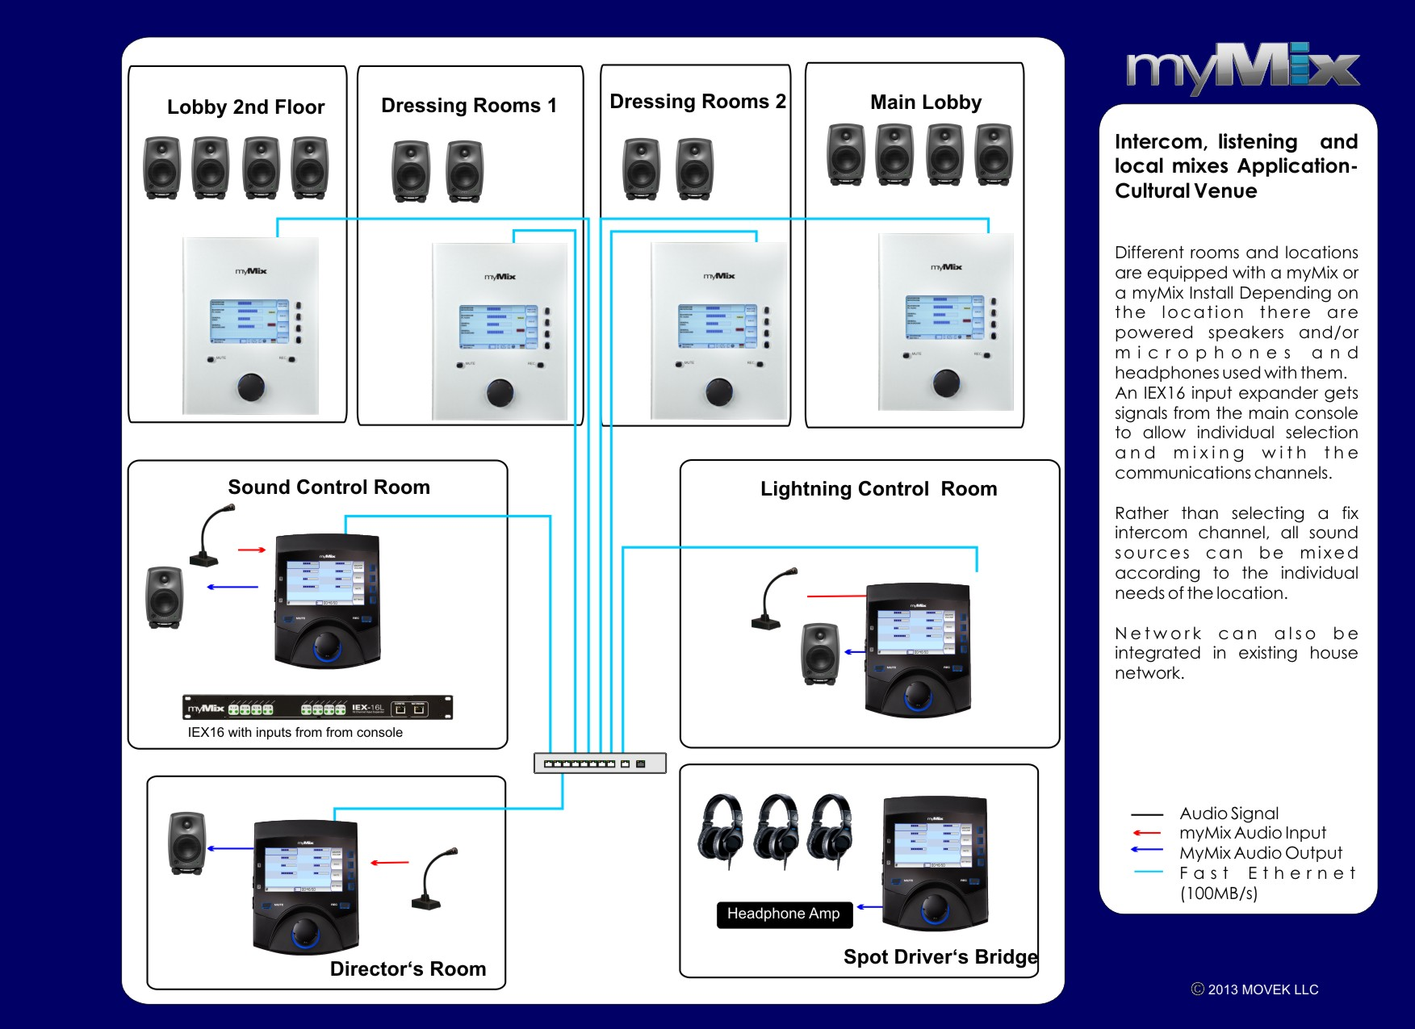

Slide 41
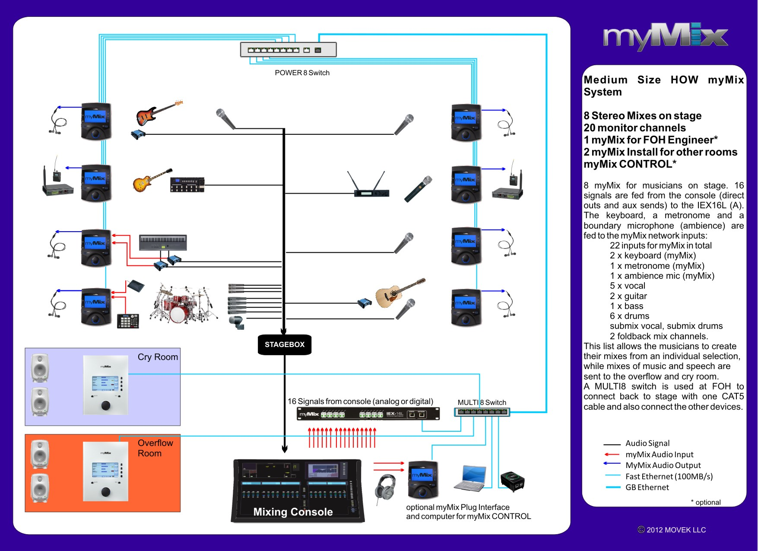

Slide 42
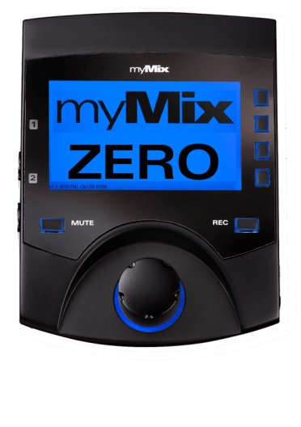
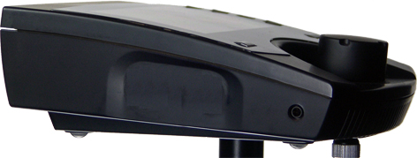
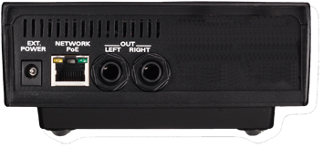
myMix ZERO
myMix Network Mixer
Without local inputs and SD card reader
Cost saving alternative, fully compatible
Clear Positioning
25% savings
 | List
myMix | $ 679
myMix-ZERO | $ 459
8 myMix System | $7,081
8 myMix-ZERO System | $5,321

Slide 43
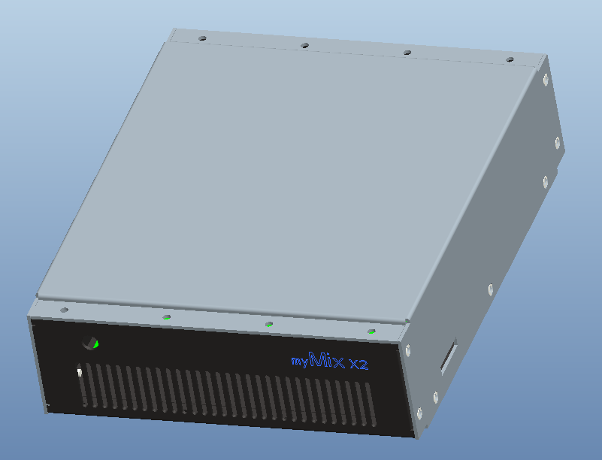
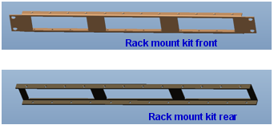
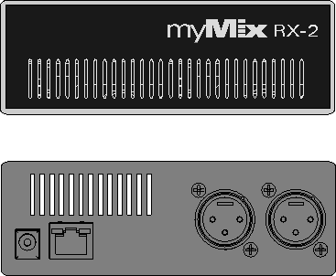
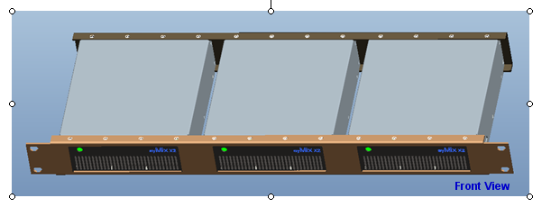
myMix RX-2 [Black Box]
myMix Network Mixer for Rackmount applications:
-- Stereo signal for wireless IEM transmitters that are away from the mixer
- Signal distribution for production companies and installations
A myMix in a metal housing – without display and buttons, 2 balanced XLR outputs, configuration with myMix Control. 3 Units fit in 1U 19”!

Slide 44
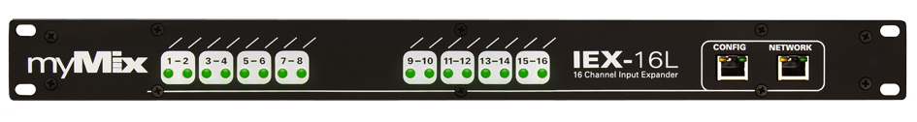
IEX16L-DANTE
IEX16 Input Expander with inputs for DANTE network
with or without 16 line level inputs

Slide 45
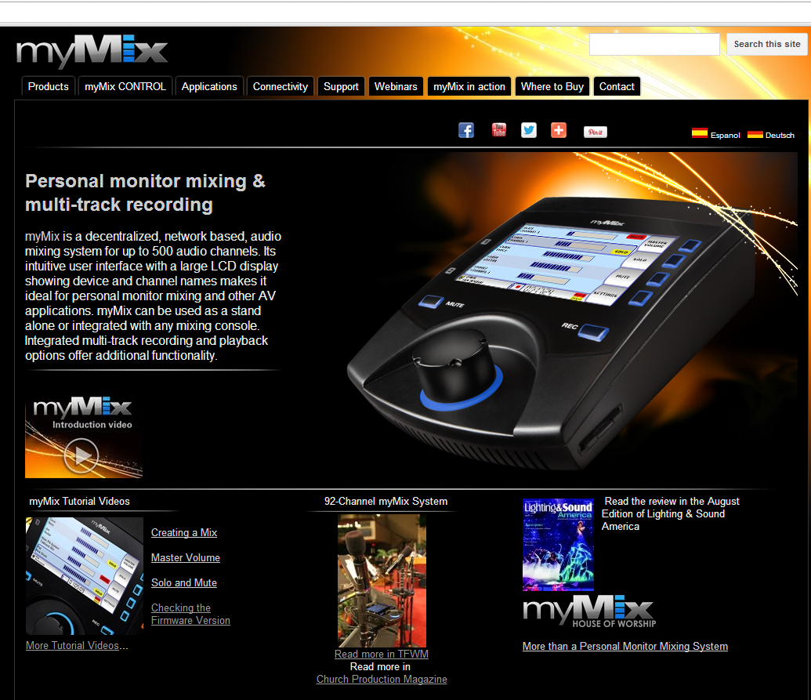
http://www.mymixaudio.com
www.mymixaudio.com

Slide 46
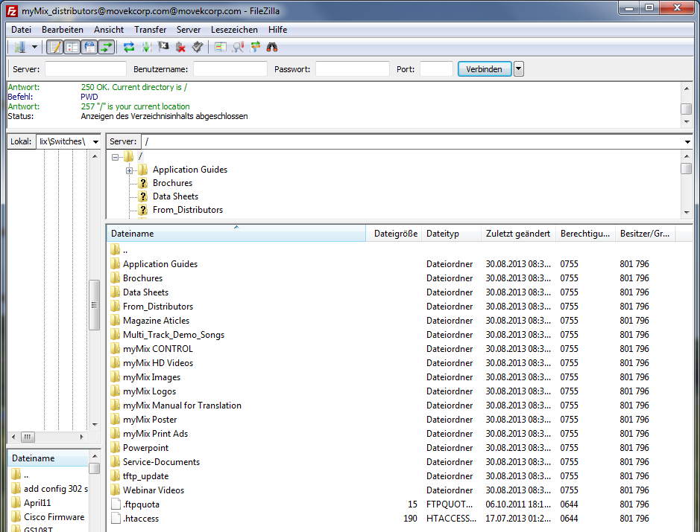
http://www.mymixaudio.com
www.mymixaudio.com
Server: ftp.movekcorp.com User: myMix_distributors@movekcorp.com

